Slide 1
UNIT-II
Problem-solving

Slide 2
Contents
Problem solving process, Problem analysis and representation, Problem space and search
Toy problems, real world problems, Problem reduction methods
General Search algorithms, Uninformed Search methods, Informed (Heuristic) Search
Best first, Greedy, A* search methods, Heuristic Functions, AO*

Slide 3
Contents
Local Search Algorithms and optimization problems
Adversarial search methods(Game Theory): Important concepts of Game theory, Game theory and knowledge structure
Game as a search problem, Alpha-Beta Pruning, Stochastic Games
Constraint Satisfaction Problem, CSP as search problem

Slide 4
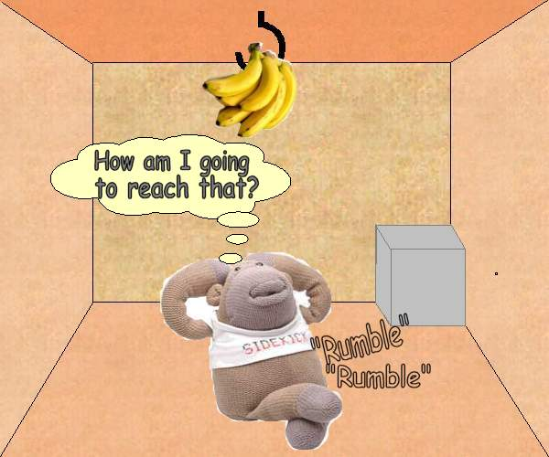
Monkey & Bananas Problem
A hungry monkey is in a room. Suspended from the roof, just out of his reach, is a bunch of bananas. In the corner of the room is a box. The monkey desperately wants the bananas but he can’t reach them. What shall he do?

Slide 5
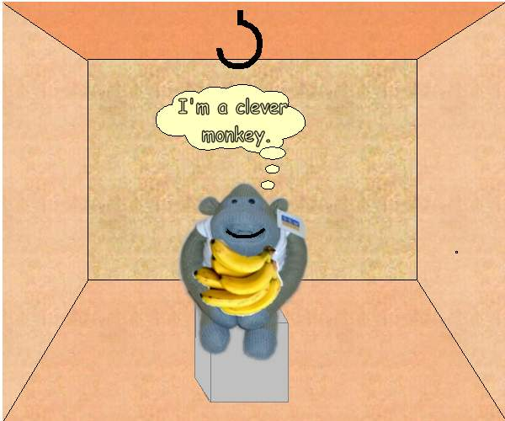
Monkey & Bananas Problem
After several unsuccessful attempts to reach the bananas, the monkey walks to the box, pushes it under the bananas, climbs on the box, picks the bananas and eats them.
The hungry monkey is now a happy monkey.

Slide 6
Planning
To solve this problem the monkey needed to devise a plan, a sequence of actions that would allow him to reach the desired goal.
Planning is an important part of many different AI applications, such as robotics and intelligent agents.
To be able to plan, a system needs to be able to reason about the individual and cumulative effects of a series of actions. This is a skill that is only observed in a few animal species and only mastered by humans.

Slide 7
Planning vs. Problem Solving
Planning is a special case of Problem Solving (Search).
Problem solving searches a state-space of possible actions, starting from an initial state and following any path that it believes will lead it the goal state.
Recording the actions along the path from the initial state to the goal state gives you a plan.

Slide 8
Problem solving
We want:
To automatically solve a problem
We need:
A representation of the problem
Algorithms that use some strategy to solve the problem defined in that representation

Slide 9
Problem-Solving Agents
Agents whose task it is to solve a particular problem
Goal formulation
what is the goal state
what are important characteristics of the goal state
how does the agent know that it has reached the goal
are there several possible goal states
are they equal or are some more preferable
Problem formulation
what are the possible states of the world relevant for solving the problem
what information is accessible to the agent
how can the agent progress from state to state

Slide 10
Problem Formulation
Formal specification for the task of the agent
goal specification
states of the world
actions of the agent
Identify the type of the problem
what knowledge does the agent have about the state of the world and the consequences of its own actions
does the execution of the task require up-to-date information
sensing is necessary during the execution

Slide 11
Problem Types
single-state problems
accessible world and knowledge of its actions allow the agent to know which state it will be in after a sequence of actions
multiple-state problems
the world is only partially accessible, and the agent has to consider several possible states as the outcome of a sequence of actions
contingency problems
at some points in the sequence of actions, sensing may be required to decide which action to take; this leads to a tree of sequences
exploration problems
the agent doesn’t know the outcome of its actions, and must experiment to discover states of the world and outcomes of actions

Slide 12
Problem representation and analysis
Problems with a readily available formal specification
initial state
starting point from which the agent sets out
actions (operators, successor functions)
describe the set of possible actions
state space
set of all states reachable from the initial state by any sequence of actions
path
sequence of actions leading from one state in the state space to another
goal test
determines if a given state is the goal state

Slide 13
Problem representation and analysis
solution
path from the initial state to a goal state
search cost
time and memory required to calculate a solution
path cost
determines the expenses of the agent for executing the actions in a path
sum of the costs of the individual actions in a path
total cost
sum of search cost and path cost
overall cost for finding a solution

Slide 14
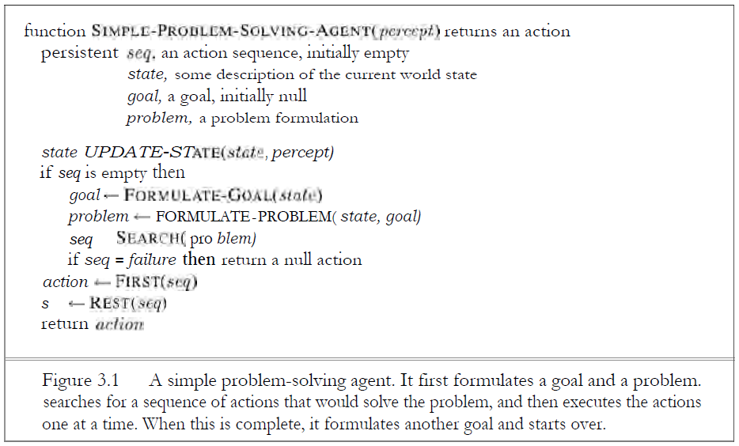
Example of a simple problem solving agent

Slide 15
Problem Analysis and Representation
Initial State: The initial state that the agent starts in.
Action: Description of possible actions available to the agent.
Successor function : It is a description of possible actions, a set of operators. This function returns a set of <action, successor>ordered pair.
State Space: The set of all states reachable from the initial state.
State space forms a graph in which nodes are states and arcs between nodes are actions.

Slide 16
Problem Analysis and Representation
Path : A path in the state space is a sequence of states connected by a sequence of actions.
Goal Test: It determines whether a given state is goal state.
Path cost: It is a function that assigns a numeric cost to each path.
Cost of path can be described as the sum of the cost of the individual actions along the path.
Solution: A path from the initial state to a goal state.

Slide 17
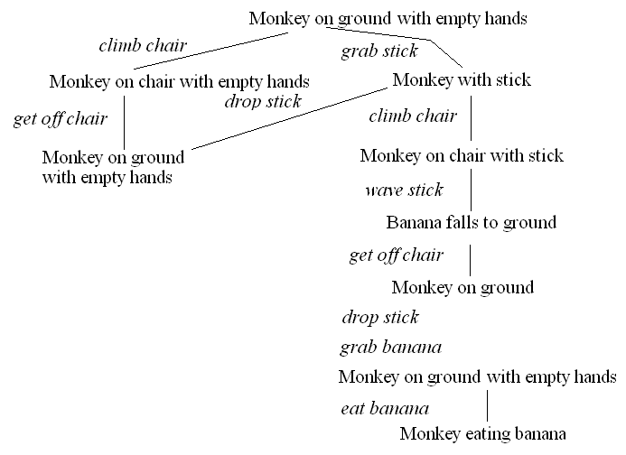
The Monkey & Bananas Problem
A monkey is in a cage and bananas are suspended from the
ceiling, the monkey wants to eat a banana but cannot reach
them
in the room are a chair and a stick
if the monkey stands on the chair and waves the stick, he can knock a banana down to eat it
what are the actions the monkey should take?
Initial state:
monkey on ground
with empty hand
bananas suspended
Goal state:
monkey eating
Actions:
climb chair/get off
grab X
wave X
eat X

Slide 18
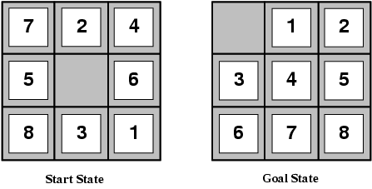
Example: 8-puzzle

Slide 19
Example: 8-puzzle
State space: configuration of the eight tiles on the board
Initial state: any configuration
Goal state: tiles in a specific order
Operators or actions: “blank moves”
Condition: the move is within the board
Transformation: blank moves Left, Right, Up, or Down
Solution: optimal sequence of operators

Slide 20
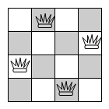
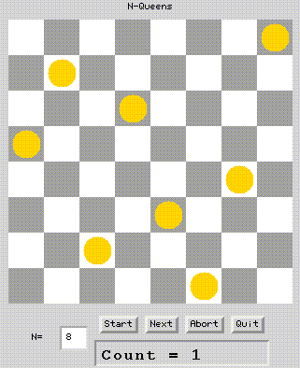
Example: n queens (n = 4, n = 8)

Slide 21
Example: n queens (n = 4, n = 8)
State space: configurations from 0 to n queens on the board with only one queen per row and column
Initial state: configuration without queens on the board
Goal state: configuration with n queens such that no queen attacks any other
Operators or actions: place a queen on the board
Condition: the new queen is not attacked by any other already placed
Transformation: place a new queen in a particular square of the board
Solution: one solution (cost is not considered)

Slide 22
Example: holiday in Romania
On holiday in Romania; currently in Arad
Flight leaves tomorrow from Bucharest at 12:00
Let’s configure this to be an AI problem.
What’s the problem?
Accomplish a goal
Reach Bucharest by 12:00

Slide 23
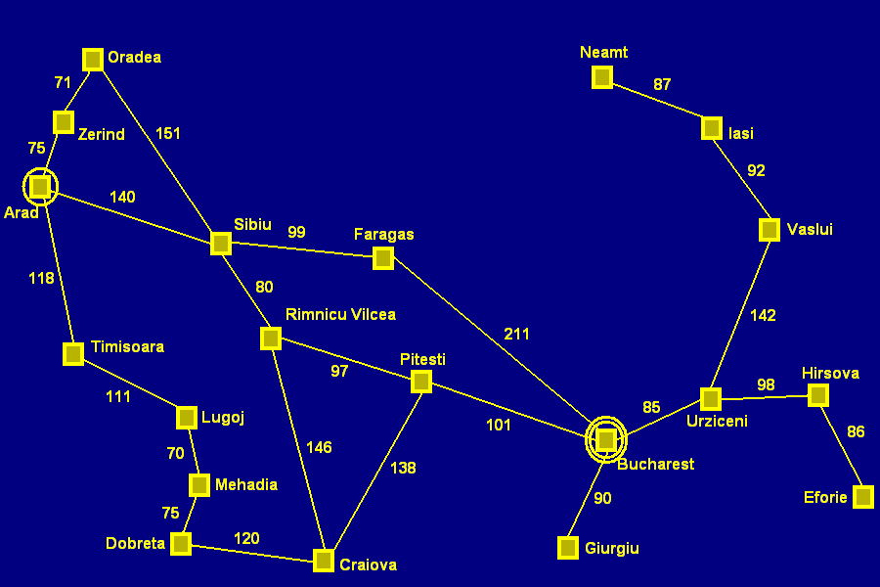
Romania

Slide 24
Example
On holiday in Romania; currently in Arad
Formulate goal:
be in Bucharest
Formulate problem:
states: various cities
actions: drive between cities
Find solution:
sequence of cities, e.g., Arad, Sibiu, Fagaras, Bucharest

Slide 25
More concrete problem definition
A state space
Which cities could you be in?
An initial state
Which city do you start from?
A goal state
Which city do you aim to reach?
A function defining state transitions
When in city foo, the following cities can be reached
A function defining the “cost” of a state sequence
How long does it take to travel through a city sequence?

Slide 26
Problem representation
A problem is defined by following components:
initial state e.g., \In(Arad)"
actions, Actions(s) returns the actions applicable in s.
e.g, In Arad, the applicable actions are
Go(Sibiu), Go(Timisoara), Go(Zerind)
goal test, can be
explicit, e.g., x = \In Bucharest"
implicit, e.g., x = \In a city with an international airport"
path cost
e.g., sum of distances, number of actions executed, etc.
A solution is a sequence of actions leading from the initial
state to a goal state.

Slide 27
Example Problems
Toy problems
Illustrate/test various problem-solving methods
Exact description
Can be used to compare performance
Examples: 8-puzzle, 8-queens problem, Crypt arithmetic, Vacuum world
Real-world problem
More difficult
Examples: Route finding, VLSI layout, Robot navigation, Assembly sequencing
Notes:
Toy problem おもちゃ問題 おもちゃもんだい
Illustrate 説明する せつめいする
Exercise 演習 えんしゅう
Concise 簡潔な かんけつな
Agreed 合意 ごうい
Description 記述 きじゅつ

Slide 28
Toy Problems The vacuum world
The vacuum world
The world has only two locations
Each location may or may not contain dirt
The agent may be in one location or the other
8 possible world states
Three possible actions: Left, Right, Suck
Goal: clean up all the dirt
1
2
3
4
5
6
7
8
Notes:
Problem type 問題のタイプ もんだいのタイプ
Vacuum cleaner 掃除機 そうじき
Location 場所 ばしょ
Suck 吸込み すいこみ

Slide 29
Toy Problems The vacuum world
States: one of the 8 states given earlier
Operators: move left, move right, suck
Goal test: no dirt left in any square
Path cost: each action costs one
R
S
S
L
R
R
S
S
L
L
R
L

Slide 30
Simple Vacuum World
states
two locations
dirty, clean
initial state
any legitimate state
successor function (operators)
left, right, suck
goal test
all squares clean
path cost
one unit per action

Slide 31
Example: The 8-puzzle

Slide 32
8-Puzzle
states
location of tiles (including blank tile)
initial state
any legitimate configuration
successor function (operators)
move tile
alternatively: move blank
goal test
any legitimate configuration of tiles
path cost
one unit per move

Slide 33

Example: n-queens
Put n queens on an n × n board with no two queens on the same row, column, or diagonal

Slide 34
8-Queens
states
arrangement of 8 queens on the board
initial state
configuration without queens on the board
successor function (operators)
move a queen to a different square
goal test
no queen attacked
path cost
irrelevant (all solutions equally valid)

Slide 35
Real-world problems
Route finding
Defined in terms of locations and transitions along links between them
Applications: routing in computer networks, automated travel advisory systems, airline travel planning systems
Traveling salesperson problems
“Visit every city on the map at least once and end in Bucharest”
Needs information about the visited cities
Goal: Find the shortest tour that visits all cities
Applications: planning movements of automatic circuit board drills
Notes:
Route finding ルート発見 ルートはっけん
Specified 規定された きていされた
Transition 遷移 せんい
Automated travel advice 自動旅行アドバイス じどうりょこうアドバイス
Airline travel planning 航空会社運行計画 こうくうがいしゃうんこうけいかく
Touring 旅行 りょこう
Traveling salesman 巡回セールスマン じゅんかいセールスマン
Visited 訪れた おとずれた
Shortest tour 最短の旅行 さいたんのりょこう
NP-hard NP-困難 NP-こんなん
Improve 改善する かいぜんする
Capability 能力 のうりょく
Circuit board drill 回路基板穿孔機 かいろきばんせんこうき

Slide 36
Real-world problems
VLSI layout
Place cells on a chip so they don’t overlap and there is
room for connecting wires to be placed between the cells
Robot navigation
Generalization of the route finding problem
No discrete set of routes
Robot can move in a continuous space
Infinite set of possible actions and states
Assembly sequencing
Automatic assembly of complex objects
The problem is to find an order in which to assemble the parts of some object
Notes:
VLSI layout VLSIレイアウト
Overlap 重なり合わす かさなりあわす
Connection 接続 せつぞく
Generalization 一般化 いっぱんか
Discrete 離散的 りさんてき
Continuous space 連続空間 れんぞくくうかん
Infinite 無限 むげん
Error 誤差 ごさ
Assembly sequencing アセンブリの順序付け アセンブリのじゅんじょうつけ
Complex 複雑 ふくざつ
Undo 取り消す とりけす

Slide 37
Route Finding
states
locations
initial state
starting point
successor function (operators)
move from one location to another
goal test
arrive at a certain location
path cost
may be quite complex
money, time, travel comfort

Slide 38
Traveling Salesperson
states
locations / cities
states
each city may be visited only once
visited cities must be kept as state information
initial state
starting point
no cities visited
successor function (operators)
move from one location to another one
goal test
all locations visited
agent at the initial location
path cost
distance between locations

Slide 39
VLSI Layout
states
positions of components, wires on a chip
initial state
incremental: no components placed
complete-state: all components placed (e.g. randomly, manually)
successor function (operators)
incremental: place components, route wire
complete-state: move component, move wire
goal test
all components placed
components connected as specified
path cost
may be complex
distance, capacity, number of connections per component

Slide 40
Robot Navigation
states
locations
position of actuators
initial state
start position (dependent on the task)
successor function (operators)
movement, actions of actuators
goal test
task-dependent
path cost
may be very complex
distance, energy consumption

Slide 41
Assembly Sequencing
states
location of components
initial state
no components assembled
successor function (operators)
place component
goal test
system fully assembled
path cost
number of moves

Slide 42
Problem space and search
Traversal of the search space
from the initial state to a goal state
legal sequence of actions as defined by successor function (operators)
General procedure
check for goal state
expand the current state
determine the set of reachable states
return “failure” if the set is empty
select one from the set of reachable states
move to the selected state
A search tree is generated
nodes are added as more states are visited
Initial state and successor function(State Space)

Slide 43
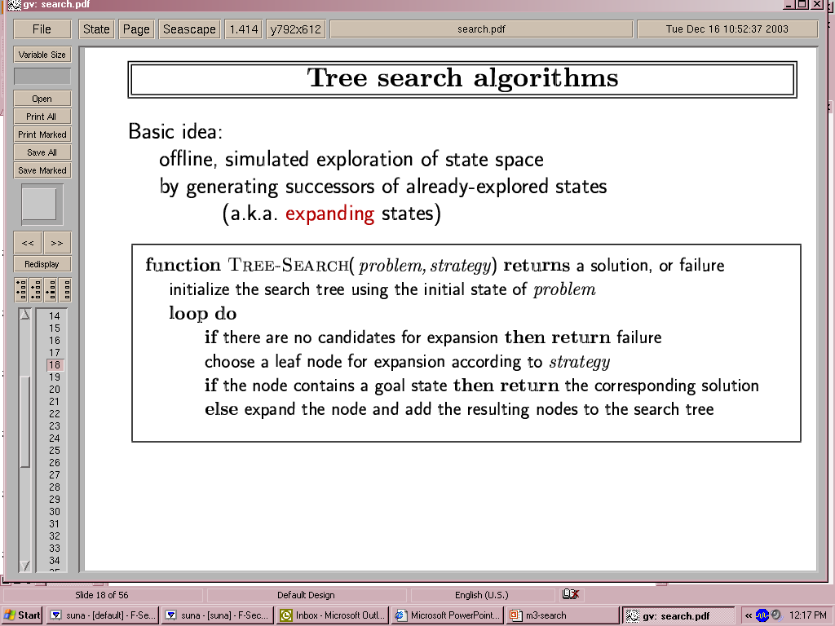
Tree-search algorithms
-> Here we only check a node for possibly being a goal state, after we select the node for expansion.
-> A “node” is a data structure containing state + additional info (parent
node, etc.)

Slide 44
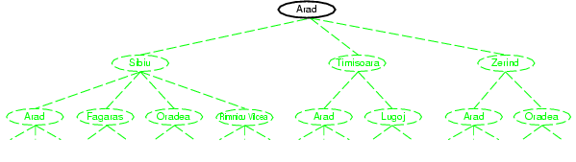
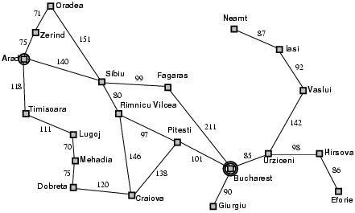
Tree search example
Node selected
for expansion

Slide 45
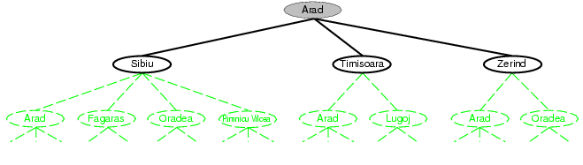
Nodes added to tree.

Slide 46
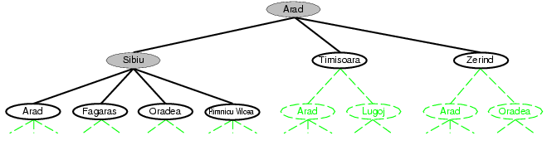
Selected for expansion.
Added to tree.
-> Arad added (again) to tree!
(reachable from Sibiu)
->Not necessarily a problem, but in Graph-Search, we will avoid this by maintaining an
“explored” list.

Slide 47
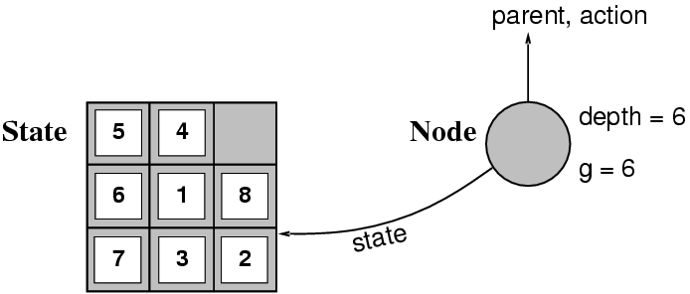
Implementation: states vs. nodes
A state is a --- representation of --- a physical configuration.
A node is a data structure constituting part of a search tree includes state, tree parent node, action (applied to parent), path cost (initial state to node) g(x), depth
Fringe is the collection of nodes that have been generated but not (yet) expanded.

Slide 48
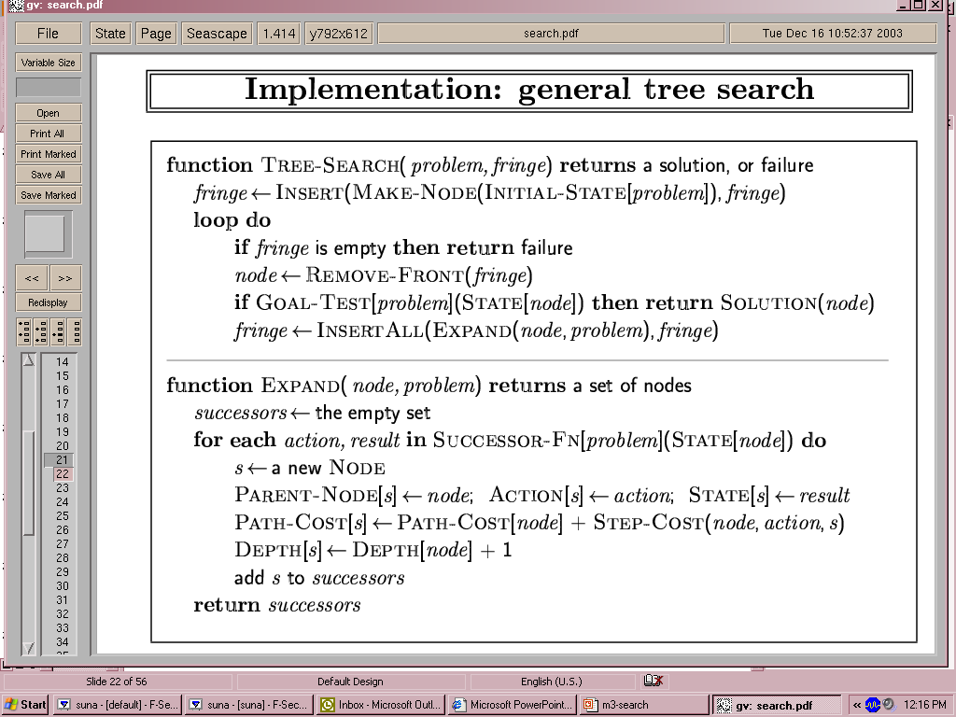
Implementation: general tree search

Slide 49
Measuring Problem Solving Performance
A strategy is defined by picking the order of node expansion.
Strategies are evaluated along the following dimensions:
Completeness
Time complexity
Space complexity
Optimality

Slide 50
Measuring Problem Solving Performance
Completeness
Is the algorithm guaranteed to find a solution when there is one?
Time complexity
How long does it take to find solution?
Space complexity
How much memory is needed to perform the search
Optimality
Does the strategy find optimal solution when there is one?

Slide 51
Measuring Problem Solving Performance
Time and space complexity are measured in terms of:
b – maximum branching factor of the search tree (may be infinite)
d – depth of the least-cost solution
m – maximum depth of the state space (may be infinite)

Slide 52
Branching factor of the search space (b): how many operators (at most) can be applied at any time?
E.g. For the eight-puzzle problem, the branching factor is considered 4,
Although most of the time we can apply only 2 or 3 operators.
Solution depth (d): how long is the path to the closest (shallowest)solution?

Slide 53
Types of Problem Spaces
There are several types of problem spaces:
State space
Problem Reduction Space
AND/OR Graphs

Slide 54
State Space
The states represent situations of the problem.
The operators represent actions in the world.
forward search: the root of the problem space represents the start state, and the search proceeds forward to a goal state.
backward search : the root of the problem space represents the goal state, and the search proceeds backward to the initial state.
For example: In Sliding-Tile Puzzle, either a forward or backward search are possible.

Slide 55
Problem Reduction Space
In a problem reduction space, the nodes represent problems to be solved or goals to be achieved, and the edges represent the decomposition of the problem into subproblems.
This is best illustrated by the example of the Towers of Hanoi problem.
A
B
C
A
B
C

Slide 56
Problem Reduction Space
The root node, labeled “3AC” represents the original problem of transferring all 3 disks from peg A to peg C.
The goal can be decomposed into three subgoals: 2AB, 1AC, 2BC. In order to achieve the goal, all 3 subgoals must be achieved.
3AC
2AB
1AC
2BC
1AC
1AB
1CB
1BA
1BC
1AC

Slide 57
Problem Reduction Space
A
B
C
3AC

Slide 58
Problem Reduction Space
A
B
C
3AC
2AB
1AC

Slide 59
Problem Reduction Space
A
B
C
3AC
2AB
1AC
1AB

Slide 60
Problem Reduction Space
A
B
C
3AC
2AB
1AC
1AB
1CB

Slide 61
Problem Reduction Space
A
B
C
3AC
2AB
1AC
1AC
1AB
1CB

Slide 62
Problem Reduction Space
A
B
C
3AC
2AB
1AC
2BC
1AC
1AB
1CB
1BA

Slide 63
Problem Reduction Space
A
B
C
3AC
2AB
1AC
2BC
1AC
1AB
1CB
1BA
1BC

Slide 64
Problem Reduction Space
A
B
C
3AC
2AB
1AC
2BC
1AC
1AB
1CB
1BA
1BC
1AC

Slide 65
AND/OR Graphs
An AND graph consists entirely of AND nodes, and in order to solve a problem represented by it, you need to solve the problems represented by all of his children (Hanoi towers example).
An OR graph consists entirely of OR nodes, and in order to solve the problem represented by it, you only need to solve the problem represented by one of his children (Eight Puzzle Tree example).

Slide 66
AND/OR Graphs
An AND/OR graph consists of both AND nodes and OR nodes.
One source of AND/OR graphs is a problem where the effect of an action cannot be predicted in advanced, as in an interaction with the physical world.

Slide 67
AND/OR Graph
Breaking a problem down into smaller sub-problems (or sub-goals).
Can be represented using goal trees (or and-or trees).
Nodes in the tree represent sub-problems.
The root node represents the overall problem.
Some nodes are and nodes, meaning all their children must be solved.
Several arcs indicate a different ways of solving problem.
Useful for representing the solution of problem by decomposing it into smaller sub-problems

Slide 68
AND/OR Graph
Each sub-problem is solved and final solution is obtained by combining solutions of each sub-problem.
Decomposition generates arcs that we will call AND arc.
One AND arc may point to any number of successors, all of which must be solved.
Such structure is called AND–OR graph rather than simply AND graph.

Slide 69
Solution subgraph for AND/OR trees
In general, a solution to an AND/OR graph is a subgraph with the following properties:
It contains the root node. For every OR node included in the solution subgraph, one child is included.
For every OR node included in the solution subgraph, all the children are included.
Every terminal node in the solution subgraph is a solved node.

Slide 70
Example of AND-OR Tree

Slide 71
AND–OR Graph Search
Traverse AND-OR graph, starting from the initial node and follow the current best path.
Accumulate the set of nodes that are on the best path which have not yet been expanded.
Pick up one of these unexpanded nodes and expand it.
Add its successors to the graph and compute f (using only h) for each of them.

Slide 72
Contd.. Example
Consider AND-OR graph given on next slide.
Let us assume that each arc with single successor will have a cost of 1 and each AND arc with multiple successor will have a cost of 1 for each of its components for the sake of simplicity.
Here the numbers listed in the circular brackets ( ) are estimated cost and the revised costs are enclosed in square brackets [ ].
Thick lines indicate paths from a given node.

Slide 74
Explanation
Initially we start from start node A and compute heuristic values for each of its successors, say {B, (C and D)} as {19, (8, 9)}.
The estimated cost of paths from A to B is 20 (19 + cost of one arc from A to B) and from A to (C and D) path is 19 ( 8+9 + cost of two arcs A to C and A to D).
The path from A to (C and D) seems to be better. So expand this AND path by expending C to {(G and H)} and D to {(I and J)}.

Slide 75
Contd..
Now heuristic values of G, H, I and J are 3, 4, 8 and 7 respectively.
This leads to revised cost of C and D as 9 and 17 respectively.
These values are propagated up and the revised costs of path from A through (C and D) is calculated as 28 (9 + 17 + cost of arcs A to C and A to D).
Now the revised cost of this path is 28 instead of earlier estimation of 19 and this path is no longer a best path.

Slide 76
Contd..
Then choose path from A to B for expansion.
After expansion we see that heuristic value of node B is 17 thus making cost of path from A to B to be 18.
This path is still best path so far, so further explore path from A to B.
The process continues until either a solution is found or all paths have lead to dead ends, indicating that there is no solution.

Slide 77
Search Strategies
Uninformed search strategies
Generate states
Test them
With the goal
Incredibly inefficient in most cases
Informed search strategies
Problem-specific
knowledge
Evaluation
Eval(State)
?
Eval(Goal)
Find solution more efficiency

Slide 78
Search Strategies
If a state is not a goal, we cannot tell how close to the goal it might be.
Hence, all we can do is move systematically between states until we stumble on a goal.
In contrast, informed (heuristic) search uses a guess on how close to the goal a state might be.

Slide 79
Uninformed vs. informed
Blind (or uninformed) search algorithms:
Solution cost is not taken into account.
Heuristic (or informed) search algorithms:
A solution cost estimation is used to guide the search.
The optimal solution, or even a solution, are not guaranteed.

Slide 80
Uninformed Search Strategies
Uninformed strategies use only the information available in the problem definition.
Breadth-first search
Uniform-cost search
Depth-first search
Depth-limited search
Iterative deepening search
Bidirectional Search

Slide 81
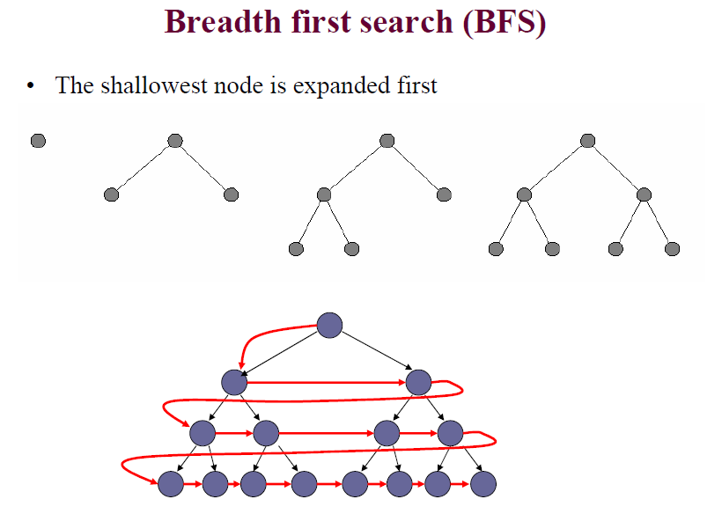
Breadth-First

Slide 82
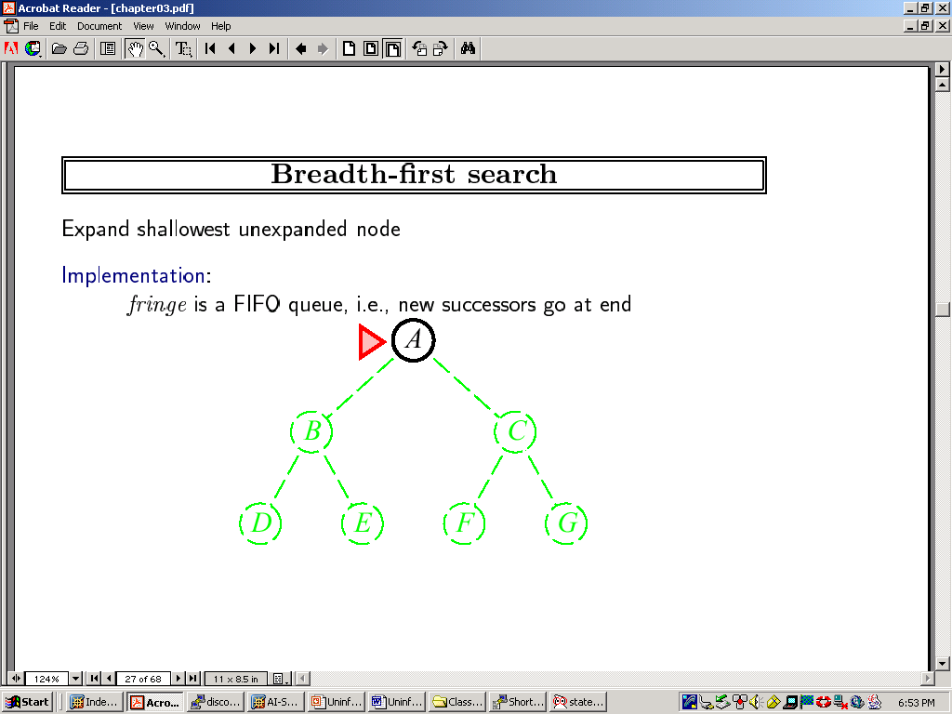

Slide 83
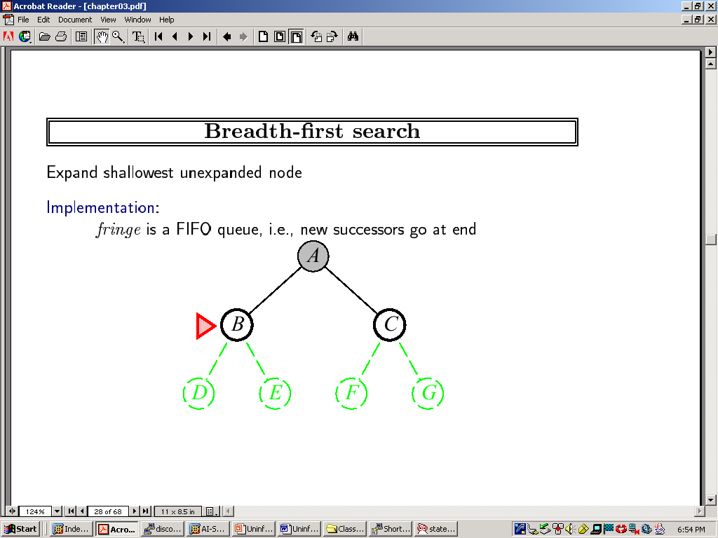

Slide 84
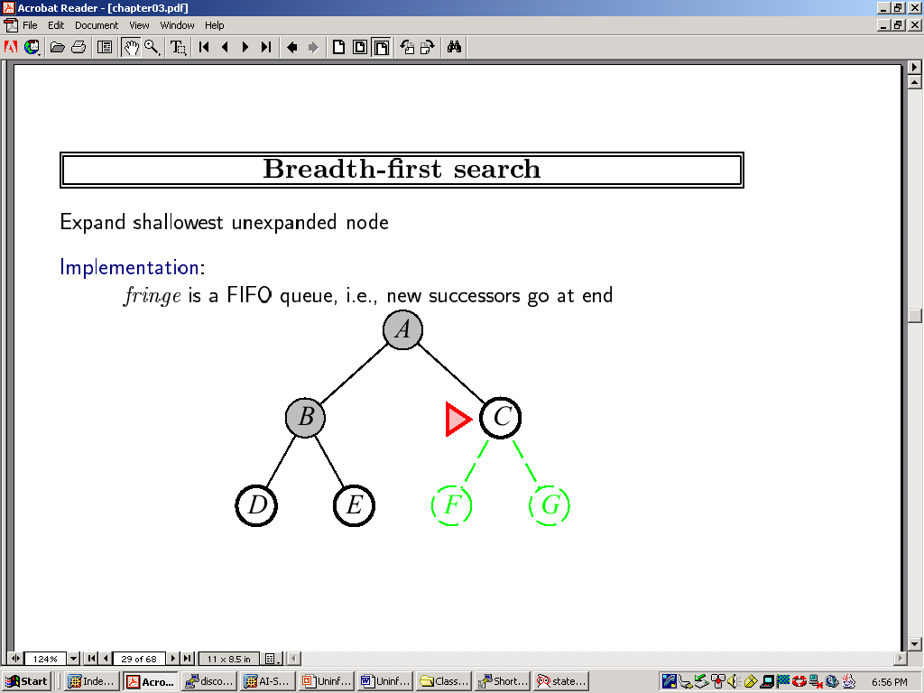

Slide 85
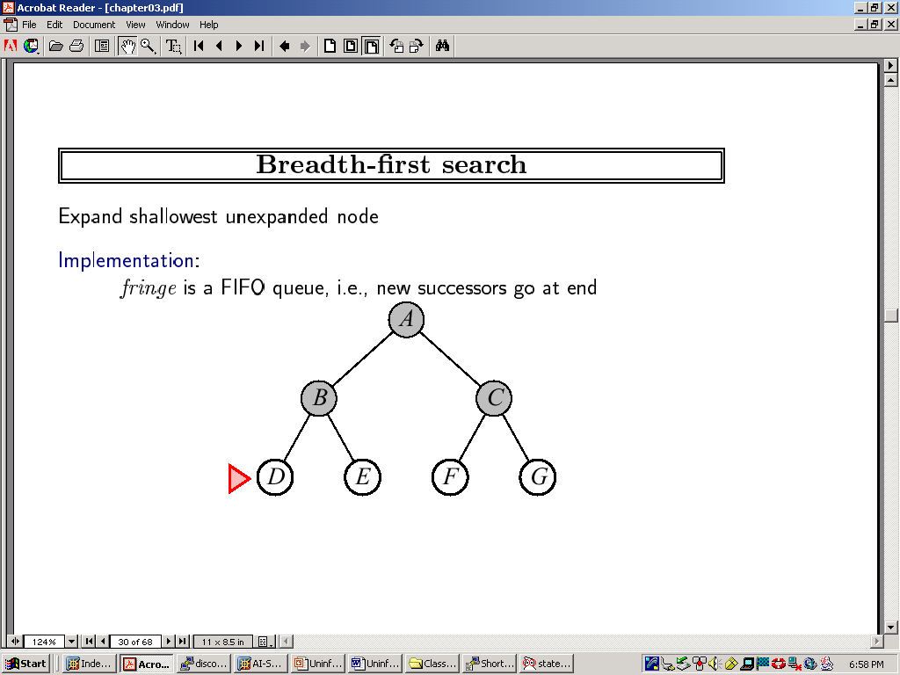

Slide 86
Breadth-First
All the nodes reachable from the current node are explored first
achieved by the GENERAL-SEARCH method by appending newly generated nodes at the end of the search queue
function BREADTH-FIRST-SEARCH(problem) returns solution
return GENERAL-SEARCH(problem, ENQUEUE-AT-END)

Slide 87
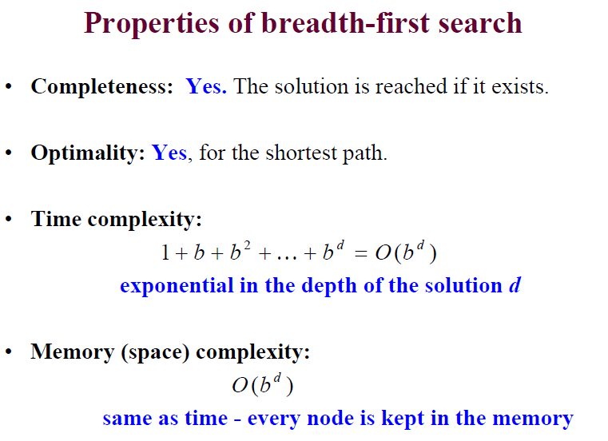
Breadth-First

Slide 88
Breadth-First Snapshot 1
Initial
1
Visited
Fringe
2
3
Current
Visible
Goal
Fringe: [] + [2,3]
Notes:
The current node [1] already has been removed from the fringe, and the new ones [2,3] will be added.

Slide 89
Breadth-First Snapshot 2
Initial
1
Visited
Fringe
2
3
Current
Visible
Goal
4
5
Fringe: [3] + [4,5]

Slide 90
Breadth-First Snapshot 3
Initial
1
Visited
Fringe
2
3
Current
Visible
Goal
4
5
6
7
Fringe: [4,5] + [6,7]

Slide 91
Breadth-First Snapshot 4
Initial
1
Visited
Fringe
2
3
Current
Visible
Goal
4
5
6
7
8
9
Fringe: [5,6,7] + [8,9]

Slide 92
Breadth-First Snapshot 5
Initial
1
Visited
Fringe
2
3
Current
Visible
Goal
4
5
6
7
8
9
10
11
Fringe: [6,7,8,9] + [10,11]

Slide 93
Breadth-First Snapshot 6
Initial
1
Visited
Fringe
2
3
Current
Visible
Goal
4
5
6
7
8
9
10
11
12
13
Fringe: [7,8,9,10,11] + [12,13]

Slide 94
Breadth-First Snapshot 7
Initial
1
Visited
Fringe
2
3
Current
Visible
Goal
4
5
6
7
8
9
10
11
12
13
14
15
Fringe: [8,9.10,11,12,13] + [14,15]

Slide 95
Breadth-First Snapshot 8
Initial
1
Visited
Fringe
2
3
Current
Visible
Goal
4
5
6
7
8
9
10
11
12
13
14
15
16
17
Fringe: [9,10,11,12,13,14,15] + [16,17]

Slide 96
Breadth-First Snapshot 9
Initial
1
Visited
Fringe
2
3
Current
Visible
Goal
4
5
6
7
8
9
10
11
12
13
14
15
16
17
18
19
Fringe: [10,11,12,13,14,15,16,17] + [18,19]

Slide 97
Breadth-First Snapshot 10
Initial
1
Visited
Fringe
2
3
Current
Visible
Goal
4
5
6
7
8
9
10
11
12
13
14
15
16
17
18
19
20
21
Fringe: [11,12,13,14,15,16,17,18,19] + [20,21]

Slide 98
Breadth-First Snapshot 11
Initial
1
Visited
Fringe
2
3
Current
Visible
Goal
4
5
6
7
8
9
10
11
12
13
14
15
16
17
18
19
20
21
22
23
Fringe: [12, 13, 14, 15, 16, 17, 18, 19, 20, 21] + [22,23]

Slide 99
Breadth-First Snapshot 12
Initial
1
Visited
Fringe
2
3
Current
Visible
Goal
4
5
6
7
Note:
The goal node is “visible” here, but we can not perform the goal test yet.
8
9
10
11
12
13
14
15
16
17
18
19
20
21
22
23
24
25
Fringe: [13,14,15,16,17,18,19,20,21] + [24,25]

Slide 100
Breadth-First Snapshot 13
Initial
1
Visited
Fringe
2
3
Current
Visible
Goal
4
5
6
7
8
9
10
11
12
13
14
15
16
17
18
19
20
21
22
23
24
25
26
27
Fringe: [14,15,16,17,18,19,20,21,22,23,24,25] + [26,27]

Slide 101
Breadth-First Snapshot 14
Initial
1
Visited
Fringe
2
3
Current
Visible
Goal
4
5
6
7
8
9
10
11
12
13
14
15
16
17
18
19
20
21
22
23
24
25
26
27
28
29
Fringe: [15,16,17,18,19,20,21,22,23,24,25,26,27] + [28,29]

Slide 102
Breadth-First Snapshot 15
Initial
1
Visited
Fringe
2
3
Current
Visible
Goal
4
5
6
7
8
9
10
11
12
13
14
15
16
17
18
19
20
21
22
23
24
25
26
27
28
29
30
31
Fringe: [16,17,18,19,20,21,22,23,24,25,26,27,28,29] + [30,31]

Slide 103
Breadth-First Snapshot 16
Initial
1
Visited
Fringe
2
3
Current
Visible
Goal
4
5
6
7
8
9
10
11
12
13
14
15
16
17
18
19
20
21
22
23
24
25
26
27
28
29
30
31
Fringe: [17,18,19,20,21,22,23,24,25,26,27,28,29,30,31]

Slide 104
Breadth-First Snapshot 17
Initial
1
Visited
Fringe
2
3
Current
Visible
Goal
4
5
6
7
8
9
10
11
12
13
14
15
16
17
18
19
20
21
22
23
24
25
26
27
28
29
30
31
Fringe: [18,19,20,21,22,23,24,25,26,27,28,29,30,31]

Slide 105
Breadth-First Snapshot 18
Initial
1
Visited
Fringe
2
3
Current
Visible
Goal
4
5
6
7
8
9
10
11
12
13
14
15
16
17
18
19
20
21
22
23
24
25
26
27
28
29
30
31
Fringe: [19,20,21,22,23,24,25,26,27,28,29,30,31]

Slide 106
Breadth-First Snapshot 19
Initial
1
Visited
Fringe
2
3
Current
Visible
Goal
4
5
6
7
8
9
10
11
12
13
14
15
16
17
18
19
20
21
22
23
24
25
26
27
28
29
30
31
Fringe: [20,21,22,23,24,25,26,27,28,29,30,31]

Slide 107
Breadth-First Snapshot 20
Initial
1
Visited
Fringe
2
3
Current
Visible
Goal
4
5
6
7
8
9
10
11
12
13
14
15
16
17
18
19
20
21
22
23
24
25
26
27
28
29
30
31
Fringe: [21,22,23,24,25,26,27,28,29,30,31]

Slide 108
Breadth-First Snapshot 21
Initial
1
Visited
Fringe
2
3
Current
Visible
Goal
4
5
6
7
8
9
10
11
12
13
14
15
16
17
18
19
20
21
22
23
24
25
26
27
28
29
30
31
Fringe: [22,23,24,25,26,27,28,29,30,31]

Slide 109
Breadth-First Snapshot 22
Initial
1
Visited
Fringe
2
3
Current
Visible
Goal
4
5
6
7
8
9
10
11
12
13
14
15
16
17
18
19
20
21
22
23
24
25
26
27
28
29
30
31
Fringe: [23,24,25,26,27,28,29,30,31]

Slide 110
Breadth-First Snapshot 23
Initial
1
Visited
Fringe
2
3
Current
Visible
Goal
4
5
6
7
8
9
10
11
12
13
14
15
16
17
18
19
20
21
22
23
24
25
26
27
28
29
30
31
Fringe: [24,25,26,27,28,29,30,31]

Slide 111
Breadth-First Snapshot 24
Initial
1
Visited
Fringe
2
3
Current
Visible
Goal
4
5
6
7
Note:
The goal test is positive for this node, and a solution is found in 24 steps.
8
9
10
11
12
13
14
15
16
17
18
19
20
21
22
23
24
25
26
27
28
29
30
31
Fringe: [25,26,27,28,29,30,31]

Slide 112
Uniform-Cost -First
BFS is optimal when all step costs are equal, because it always expands the shallowest unexpanded node.
Instead of expanding the shallowest node, uniform cost search, expands node n with the lowest path cost.
If all steps cost is equal, this is identical to BFS.

Slide 113
Uniform-Cost -First
The nodes with the lowest cost are explored first
Similar to BREADTH-FIRST, but with an evaluation of the cost for each reachable node
g(n) = path cost(n) = sum of individual edge costs to reach the current node(Cost from initial to current node)
function UNIFORM-COST-SEARCH(problem) returns solution
return TREE-SEARCH(problem, COST-FN, FIFO-QUEUE())
Time Complexity | b^{C*/e}
Space Complexity | b^{C*/e}
Completeness | yes (finite b, step costs >= e)
Optimality | yes
b | branching factor
C* | cost of the optimal solution
e | minimum cost per action

Slide 114
Uniform-Cost Snapshot
Initial
1
Visited
4
3
Fringe
2
3
Current
Visible
7
2
2
4
Goal
4
5
6
7
2
5
4
4
4
3
6
9
8
9
10
11
12
13
14
15
3
4
7
2
4
8
6
5
4
3
4
2
8
3
9
2
16
17
18
19
20
21
22
23
24
25
26
27
28
29
30
31
Fringe: [27(10), 4(11), 25(12), 26(12), 14(13), 24(13), 20(14), 15(16), 21(18)]
+ [22(16), 23(15)]

Slide 115
Uniform Cost Fringe Trace
[1(0)]
[3(3), 2(4)]
[2(4), 6(5), 7(7)]
[6(5), 5(6), 7(7), 4(11)]
[5(6), 7(7), 13(8), 12(9), 4(11)]
[7(7), 13(8), 12(9), 10(10), 11(10), 4(11)]
[13(8), 12(9), 10(10), 11(10), 4(11), 14(13), 15(16)]
[12(9), 10(10), 11(10), 27(10), 4(11), 26(12), 14(13), 15(16)]
[10(10), 11(10), 27(10), 4(11), 26(12), 25(12), 14(13), 24(13), 15(16)]
[11(10), 27(10), 4(11), 25(12), 26(12), 14(13), 24(13), 20(14), 15(16), 21(18)]
[27(10), 4(11), 25(12), 26(12), 14(13), 24(13), 20(14), 23(15), 15(16), 22(16), 21(18)]
[4(11), 25(12), 26(12), 14(13), 24(13), 20(14), 23(15), 15(16), 22(16), 21(18)]
[25(12), 26(12), 14(13), 24(13),8(13), 20(14), 23(15), 15(16), 22(16), 9(16), 21(18)]
[26(12), 14(13), 24(13),8(13), 20(14), 23(15), 15(16), 22(16), 9(16), 21(18)]
[14(13), 24(13),8(13), 20(14), 23(15), 15(16), 22(16), 9(16), 21(18)]
[24(13),8(13), 20(14), 23(15), 15(16), 22(16), 9(16), 29(16),21(18), 28(21)]
Goal reached!
Notation: [Red: Current Node; Black: Old Fringe Node; Green: New Fringe Node].
Assumption: New nodes with the same cost as existing nodes are added after the existing node.

Slide 116
Breadth-First vs. Uniform-Cost
Breadth-first always expands the shallowest node
only optimal if all step costs are equal
Uniform-cost considers the overall path cost
optimal for any (reasonable) cost function
non-zero, positive
Both are complete for non-extreme problems
finite number of branches
strictly positive search function

Slide 117
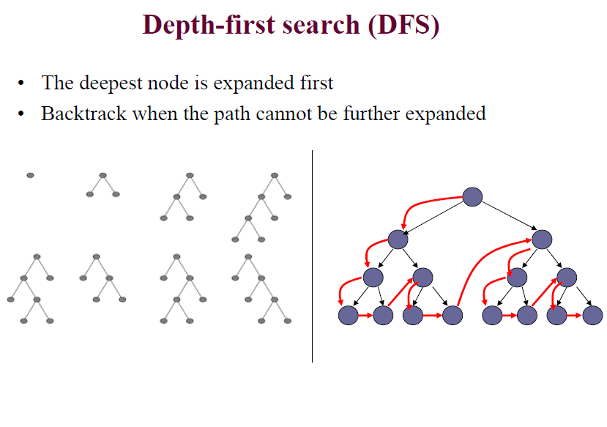
Depth First Search

Slide 118
Depth First Search
Always expand deepest node in the current fringe of the search tree.
The search proceeds immediately to the deepest level of the search tree, where the nodes have no successors.
As those nodes are expanded, they are dropped from the fringe, so then the search backs up to the next shallowest node that still has unexplored successors.

Slide 119
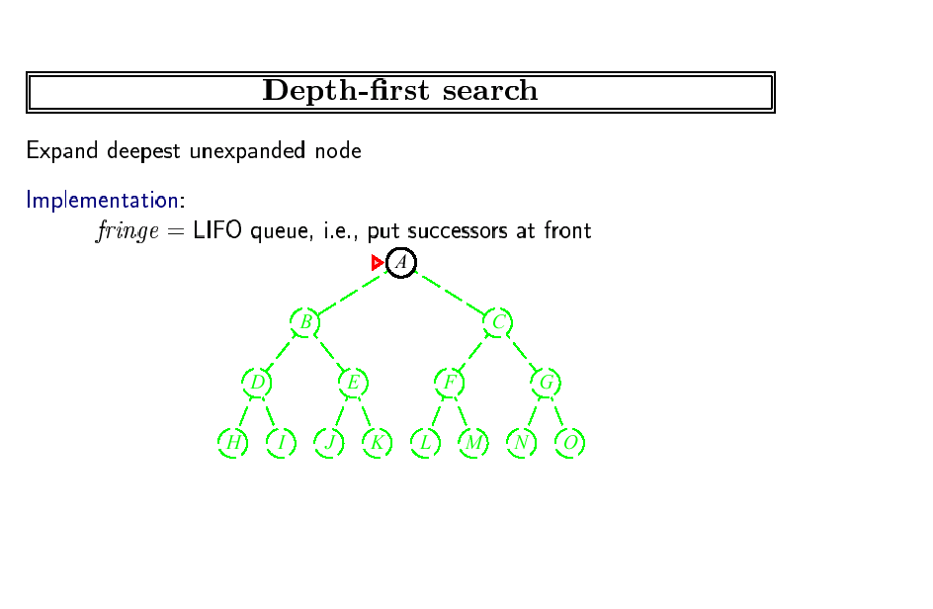
Fringe stack:
A
Expanding A,
gives stack:
B
C
So, B next.

Slide 120
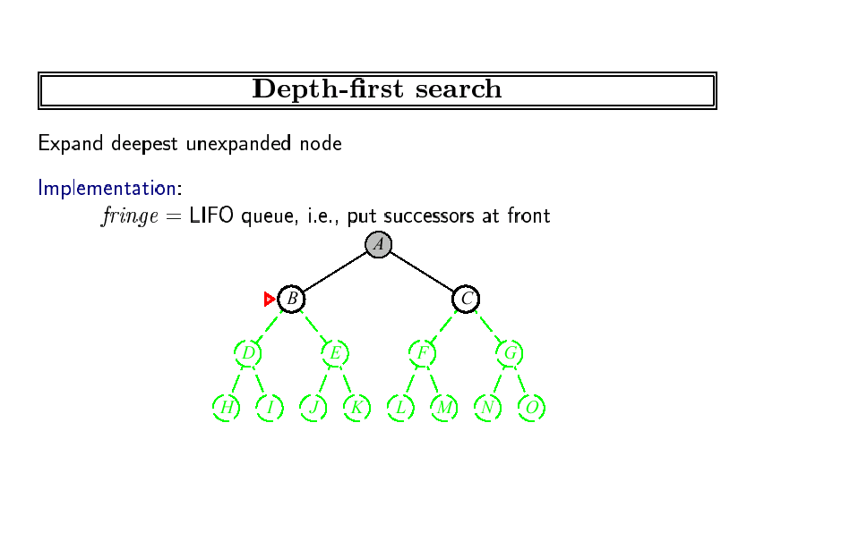
Expanding B, gives stack:
D
E
C
So, D next.

Slide 121
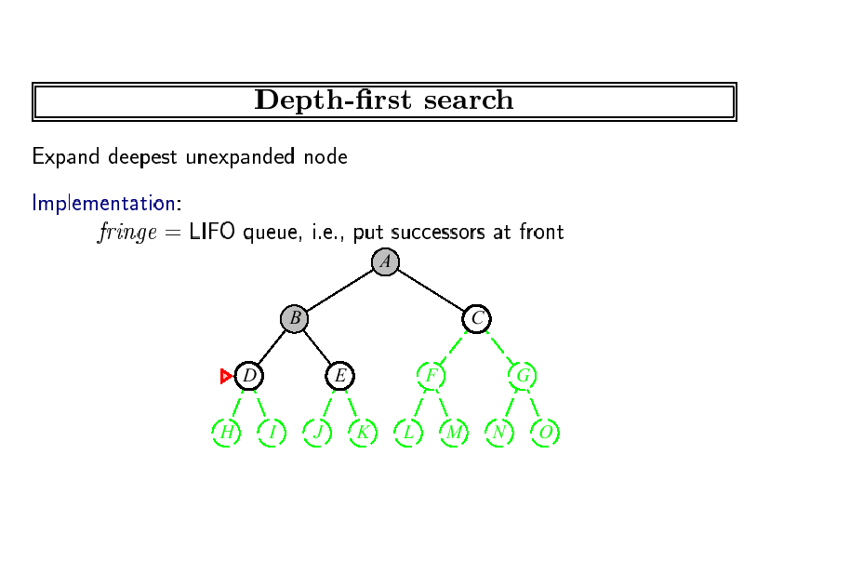
Expanding D, gives stack:
H
I
E
C
So, H next.
etc.

Slide 122
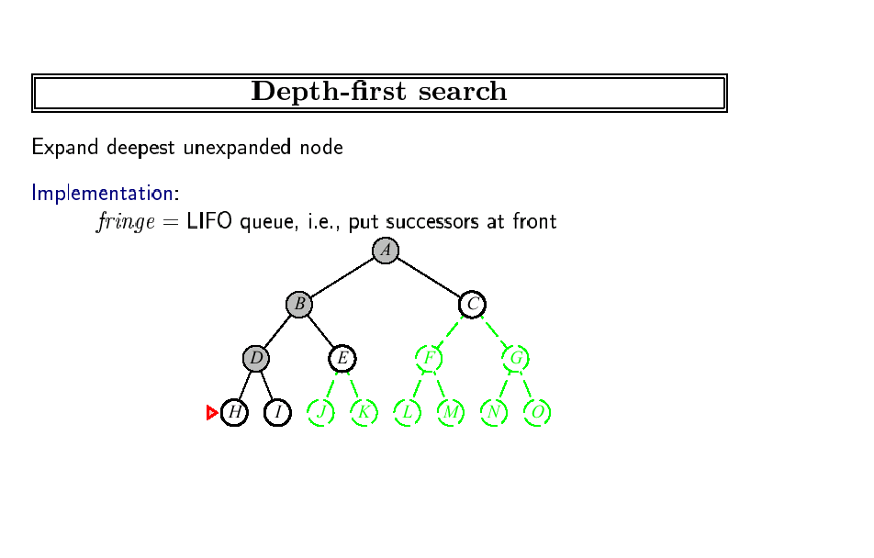
Expanding H, gives stack:
I
E
C
So, I next.
etc.

Slide 123
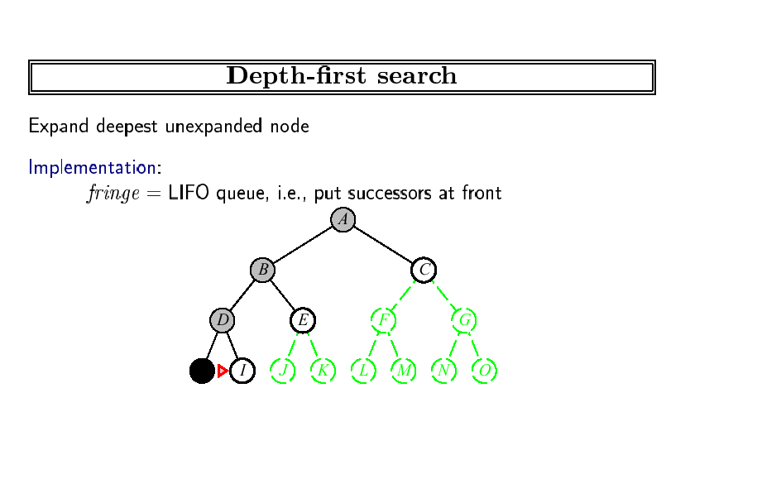
Expanding I, gives stack:
E
C
So, E next.
etc.

Slide 124
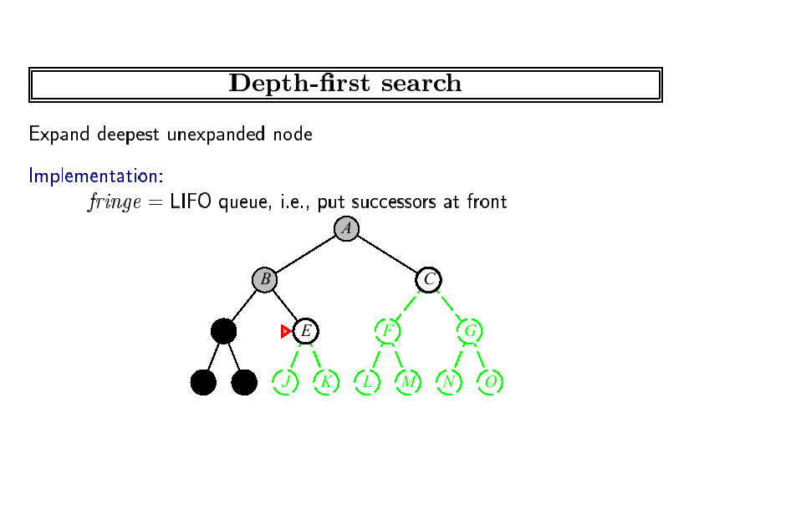
Expanding E, gives stack:
J
K
C
So, J next.

Slide 125
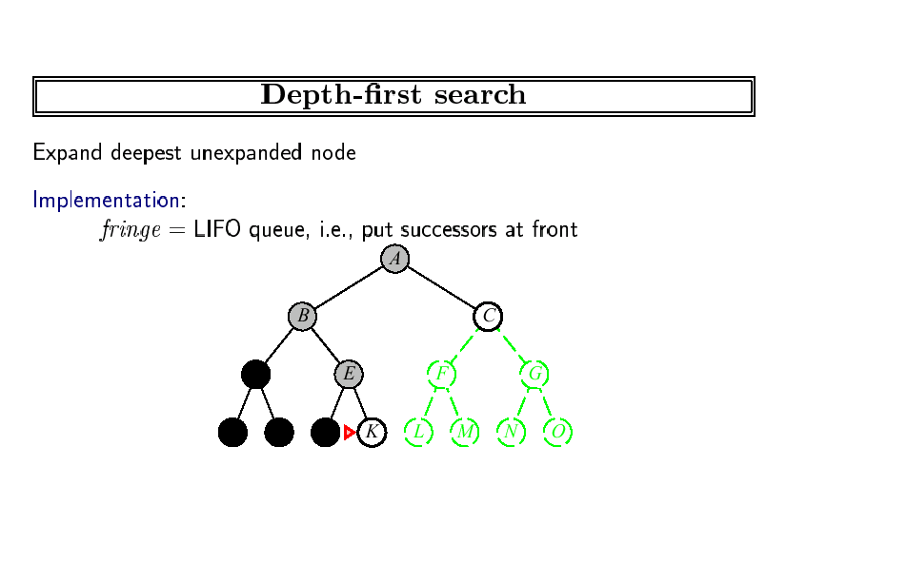
Expanding J, gives stack:
K
C
So, K next.

Slide 126
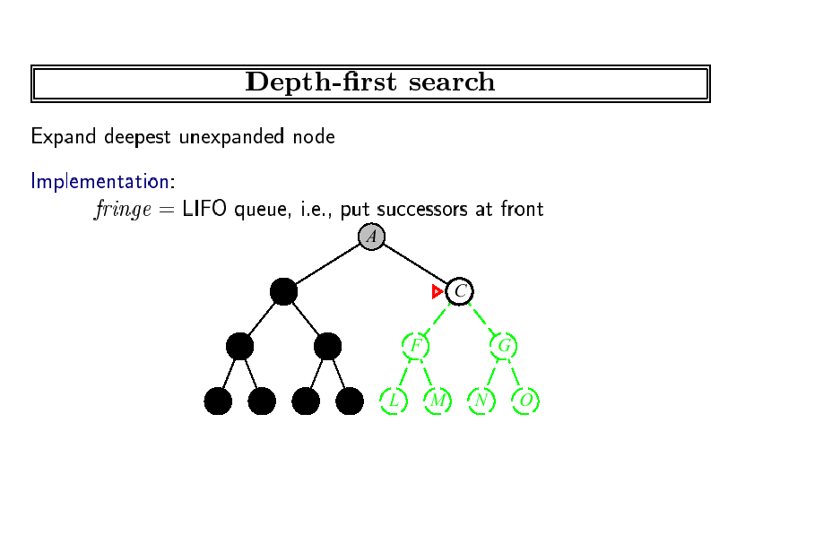
Expanding C, gives stack:
F
G
So, F next.

Slide 127
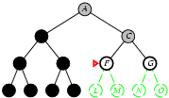
Depth First Search
Expanding F, gives stack:
L
M
G
So, L next.

Slide 128
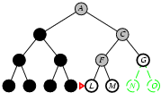
Depth First Search
Expanding L, gives stack:
M
G
So, M next.

Slide 129
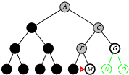
Depth First Search
Expanding m, gives stack:
G
So, G next.

Slide 130
Depth-First Search
Continues exploring newly generated nodes
achieved by the GENERAL-SEARCH method by appending newly generated nodes at the beginning of the search queue
function DEPTH-FIRST-SEARCH(problem) returns solution
return GENERAL-SEARCH(problem, ENQUEUE-AT-FRONT)

Slide 131
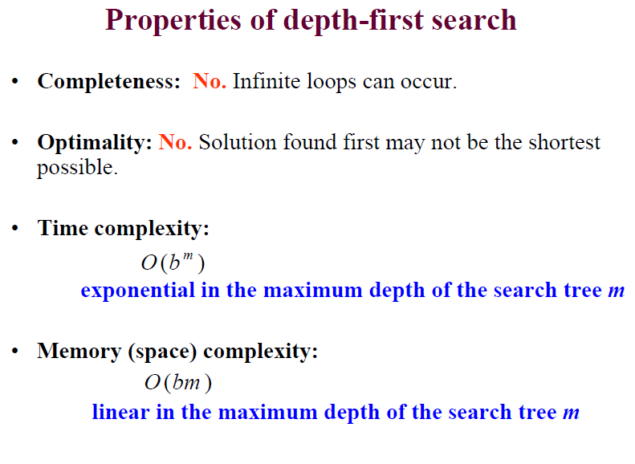
Depth-First Search

Slide 132
Backtracking Search
In backtracking, only one successor is generated at a time rather than all successors, each partially expanded node remembers which successor to generate next.
Only O(m) memory is needed rather than O(bm).
Drawback: It can make a wrong choice and get stuck going down a very long (or even infinite) path when a different choice would lead to a solution near the root of the search tree.

Slide 133
Depth limited Search
Select some limit in depth to explore the problem using DFS.
How do we select the limit?
This depth limit solves infinite path problems.
DFS can be viewed as a special case of depth-limited search with l=infinity.

Slide 134
Depth limited Search
Sometimes, Depth limits can be based on knowledge of the problem.
Example : Holiday in Romania
20 cities present in map, if there is solution, it must be length of 19 at the longest, so l=19 is a possible choice.
But any city can be reached from any other city in at most 9 steps(Diameter of state space), which gives us better depth limit.
For most problems, we will not know a good depth limit until we have solved the problem.

Slide 135
Iterative deepening
Iterative deepening depth first search
General strategy used in combination with depth first search, that’s finds the best depth limit.
It does this gradually increasing the limit- first 0, then 1, then 2 and so on- until a goal is found.
DFS with depth 1
DFS with depth 2 up to depth d

Slide 136
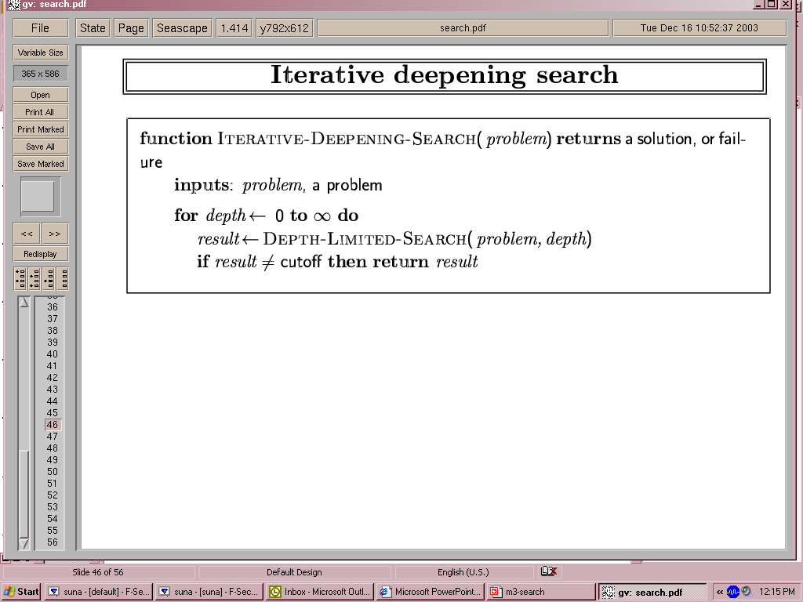
Iterative deepening
Failure : indicate no solution
Cutoff : No solution within the depth limit

Slide 137

Iterative deepening search l =0

Slide 138
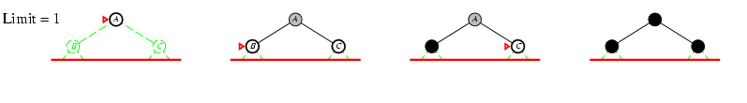
Iterative deepening search l =1

Slide 139
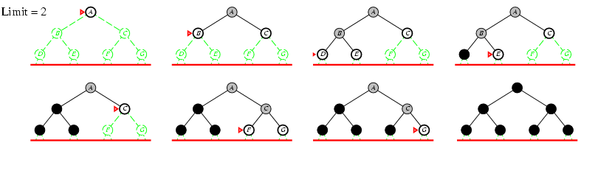
Iterative deepening search l =2

Slide 140
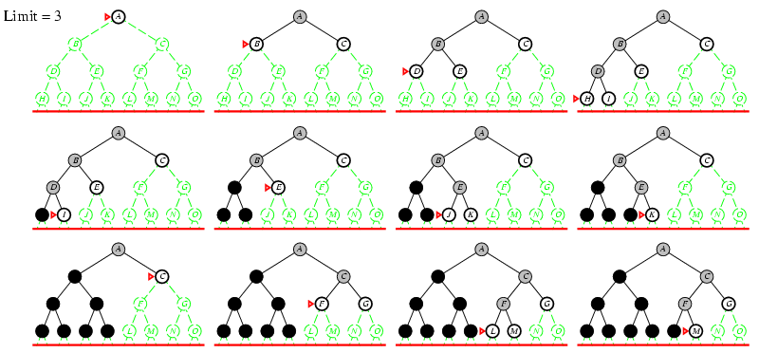
Iterative deepening search l =3

Slide 141
Iterative deepening
Number of nodes generated in an iterative deepening
search to depth d with branching factor b:
N_{IDS} = d b¹ + (d-1)b² + … + 3b^{d-2} +2b^{d-1} + 1b^{d}
Nodes generated in a breadth-first search with
branching factor b:
N_{BFS} = b¹ + b² + … + b^{d-2} + b^{d-1} + b^{d}
For b = 10, d = 5,
N_{BFS}= 10 + 100 + 1,000 + 10,000 + 100,000 = 111,110 N_{IDS} = 50 + 400 + 3,000 + 20,000 + 100,000 = 123,456
Iterative deepening is the preferred uninformed search method when there is a large search space and the depth of the solution is not known.

Slide 142
Iterative deepening
Complete? Yes
Time? d b¹ + (d-1)b² + … + b^{d} = O(b^{d})
Space? O(bd)
Optimal? Yes, if step costs identical

Slide 143
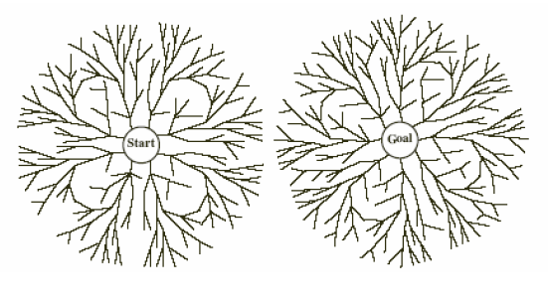
Bidirectional Search
Simultaneously:
Search forward from start
Search backward from the goal
Stop when the two searches meet.
If branching factor = b in each
direction, with solution at depth d
➔ only O(2 b^{d/2})= O(2 b^{d/2})
Space O(b^{d/2})

Slide 144
Improving Search Methods
Make algorithms more efficient
Avoiding repeated states
Utilizing memory efficiently
Use additional knowledge about the problem
properties (“shape”) of the search space
more interesting areas are investigated first
pruning of irrelevant areas
areas that are guaranteed not to contain a solution can be discarded

Slide 145
Avoiding Repeated States
In many approaches, states may be expanded multiple times
e.g. iterative deepening
problems with reversible actions
Eliminating repeated states may yield an exponential reduction in search cost
e.g. some n-queens strategies
place queen in the left-most non-threatening column
rectangular grid
4^{d} leaves, but only 2d² distinct states

Slide 146
Informed Search
Relies on additional knowledge about the problem or domain
frequently expressed through heuristics (“rules of thumb”)
It is used to distinguish more promising paths towards a goal
may be mislead, depending on the quality of the heuristic
In general, performs much better than uninformed search
but frequently still exponential in time and space for realistic problems

Slide 147
Informed Search
Best First Search
Greedy Best First Search
A* Search
Memory-Bounded Search
AO* Search

Slide 148
Best-First Search
A node is selected for expansion based on an evaluation function f(n).
Implementation : General search framework with priority queue, which will maintain the fringe in ascending order of f-value.
Choose the node that appears to be best according to the evaluation function.
Key component : Heuristic function

Slide 149
Heuristic function
Denoted by h(n).
h(n)=> Estimated cost of the cheapest path from node n to a goal node
Example, In Romania, One might estimate the cost of cheapest path from Arad to Bucharest through straight line distance from Arad to Bucharest
If n is a goal node, then h(n)=0.

Slide 150
Best-First Search
The node with the lowest value is expanded first
The node with the lowest value for the evaluation function is not necessarily one that is on an optimal path to a goal.
If we really know which one is the best, there’s no need to do a search.
function BEST-FIRST-SEARCH(problem, EVAL-FN) returns solution
fringe := queue with nodes ordered by EVAL-FN
return TREE-SEARCH(problem, fringe)

Slide 151
Best-First Search
A
A
A
B
C
D
B
C
D
3
5
1
3
5
E
F
4
6
A
A
B
C
D
B
C
D
5
5
G
H
E
F
G
H
E
F
6
5
4
6
6
5
6
I
J
2
1

Slide 152
Best-First Search
OPEN: Nodes that have been generated, but have not examined.
This is organized as a priority queue.
CLOSED: Nodes that have already been examined.
Whenever a new node is generated, check whether it has been generated before.

Slide 153
Best-First Search
Algorithm
OPEN = {initial state}.
Loop until a goal is found or there are no nodes left in OPEN:
− Pick the best node in OPEN
− Generate its successors
− For each successor:
new → evaluate it, add it to OPEN, record its parent
generated before → change parent, update successors

Slide 154
Greedy Best-First Search
Expand a node which is closed to a goal.
Evaluates nodes by using heuristics function.
f(n) = h(n)
function GREEDY-SEARCH(problem) returns solution
return BEST-FIRST-SEARCH(problem, h)

Slide 155
Greedy Best-First Search
Minimizes the estimated cost to a goal
Expand the node that seems to be closest to a goal
Utilizes a heuristic function as evaluation function
f(n) = h(n) = estimated cost from the current node to a goal
heuristic functions are problem-specific
often straight-line distance for route-finding and similar problems
Often better than depth-first.

Slide 156
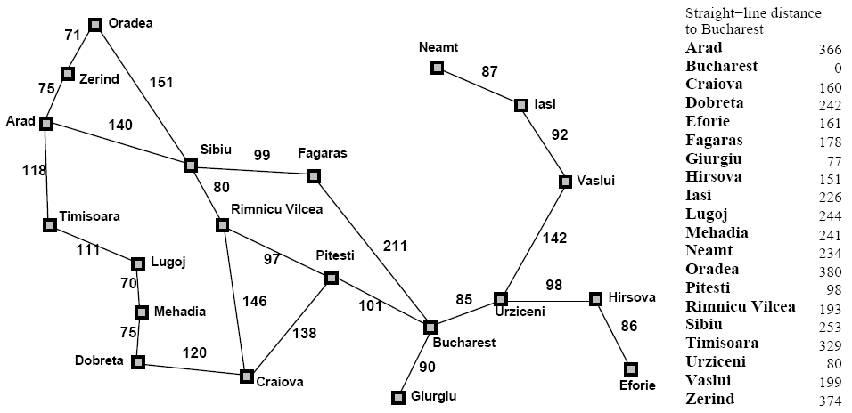
Greedy Best First Search
Route finding problem in Romania, using straight
line distance heuristics.

Slide 157

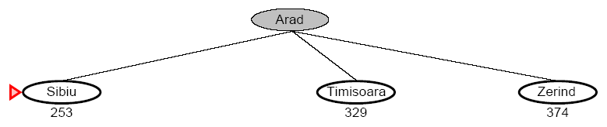
Greedy Best First Search

Slide 158
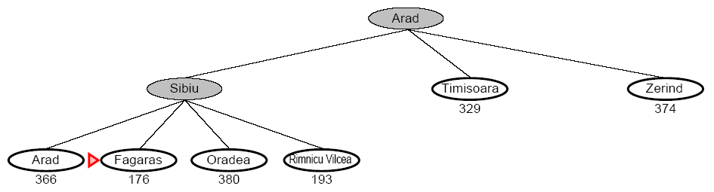
Greedy Best First Search

Slide 159
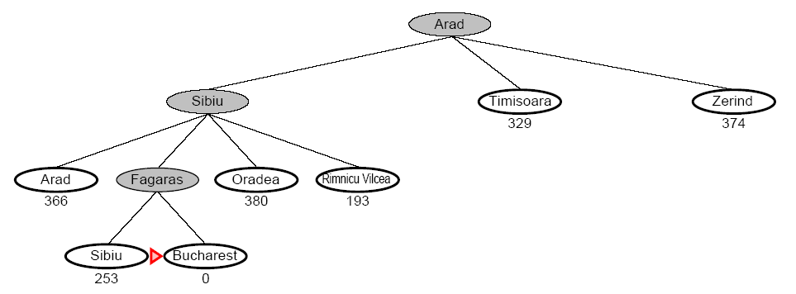
Greedy Best First Search

Slide 160
Greedy Best-First Search Snapshot
Initial
1
99
Visited
Fringe
2
7
3
7
Current
Visible
Goal
4
6
5
5
6
5
7
6
Heuristics
7
8
7
9
5
10
4
11
3
12
2
13
4
14
5
15
6
8
7
6
5
4
3
2
1
0
1
2
3
4
5
6
7
16
17
18
19
20
21
22
23
24
25
26
27
28
29
30
31
Fringe: [13(4), 7(6), 8(7)] + [24(0), 25(1)]

Slide 161
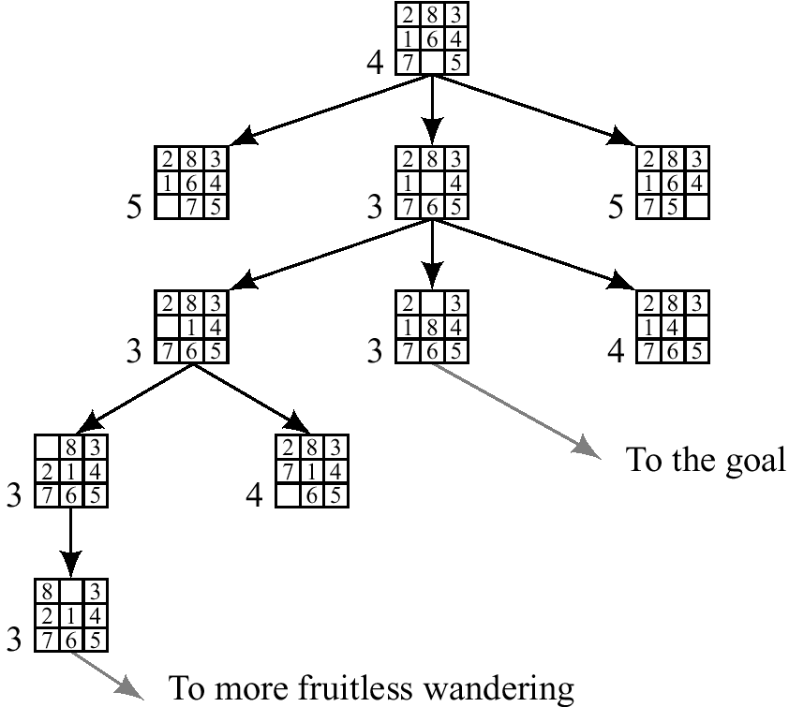
Best first (Greedy) search
h(n) = number of
misplaced tiles

Slide 162
Properties of greedy best-first search
Complete? No – can get stuck in loops, e.g., Iasi → Neamt → Iasi → Neamt →
Time? O(b^{m}), but a good heuristic can give dramatic improvement
Space? O(b^{m}) -- keeps all nodes in memory
Optimal? No

Slide 163
A* Search
Combines greedy and uniform-cost search to find the (estimated) cheapest path through the current node
f(n) = g(n) + h(n) = path cost + estimated cost to the goal
Very good search method, but with complexity problems
function A*-SEARCH(problem) returns solution
return BEST-FIRST-SEARCH(problem, g+h)

Slide 164
Algorithm A*
Input: a search graph with cost on the arcs
Output: the minimal cost path from start node to a goal node.
1. Put the start node s on OPEN.
2. If OPEN is empty, exit with failure
3. Remove from OPEN and place on CLOSED a node n having minimum f.
4. If n is a goal node exit successfully with a solution path obtained by tracing back the pointers from n to s.
5. Otherwise, expand n generating its children and directing pointers from each child node to n.
For every child node n’ do
evaluate h(n’) and compute f(n’) = g(n’) +h(n’)= g(n)+c(n,n’)+h(n)
If n’ is already on OPEN or CLOSED compare its new f with the old f and attach the lowest f to n’.
put n’ with its f value in the right order in OPEN
6. Go to step 2.

Slide 165
A* Snapshot
9
Initial
1
9
Visited
4
3
Fringe
11
10
2
7
3
7
Current
Visible
7
2
2
4
Goal
10
13
4
6
5
5
6
5
7
6
Edge Cost
9
2
5
4
4
4
3
6
9
Heuristics
11
12
7
8
7
9
5
10
4
11
3
12
2
13
4
14
5
15
6
f-cost
10
3
4
7
2
4
8
6
5
4
3
4
2
8
3
9
2
13
13
8
7
6
5
4
3
2
1
0
1
2
3
4
5
6
7
16
17
18
19
20
21
22
23
24
25
26
27
28
29
30
31
Fringe: [2(4+7), 13(3+2+3+4), 7(3+4+6)] + [24(3+2+4+4+0), 25(3+2+4+3+1)]

Slide 166
A* Snapshot with all f-Costs
Initial
1
9
Visited
4
3
Fringe
11
10
2
7
3
7
Current
Visible
7
2
2
4
Goal
17
11
10
13
4
6
5
5
6
5
7
6
Edge Cost
9
2
5
4
4
4
3
6
9
Heuristics
20
21
14
13
11
12
18
22
7
8
7
9
5
10
4
11
3
12
2
13
4
14
5
15
6
f-cost
10
3
4
7
2
4
8
6
5
4
3
4
2
8
3
9
2
24
24
29
23
18
19
18
16
13
13
14
13
25
21
31
25
8
7
6
5
4
3
2
1
0
1
2
3
4
5
6
7
16
17
18
19
20
21
22
23
24
25
26
27
28
29
30
31

Slide 167
A* Snapshot with Contour f=13
Initial
1
9
Visited
4
3
Fringe
11
10
2
7
3
7
Current
Visible
7
2
2
4
Goal
17
11
10
13
4
6
5
5
6
5
7
6
Edge Cost
9
2
5
4
4
4
3
6
9
Heuristics
20
21
14
13
11
12
18
22
7
8
7
9
5
10
4
11
3
12
2
13
4
14
5
15
6
f-cost
10
3
4
7
2
4
8
6
5
4
3
4
2
8
3
9
2
24
24
29
23
18
19
18
16
13
13
13
25
21
31
25
Contour
8
7
6
5
4
3
2
1
0
1
3
4
5
6
7
16
17
18
19
20
21
22
23
24
25
14
27
28
29
30
31
2
26

Slide 168
A* search example

Slide 169

A* search example

Slide 170
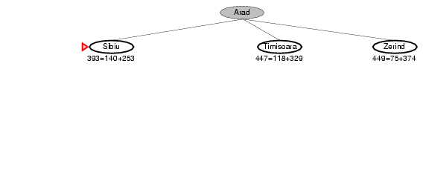
A* search example

Slide 171
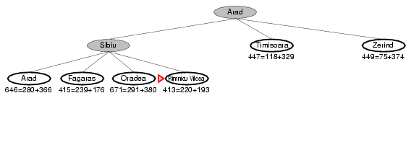
A* search example

Slide 172
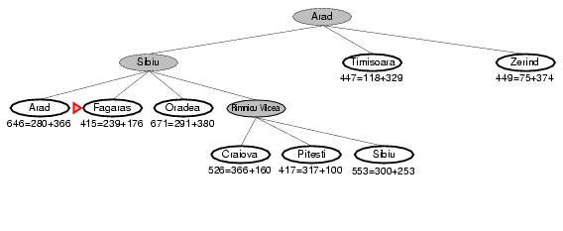
A* search example

Slide 173
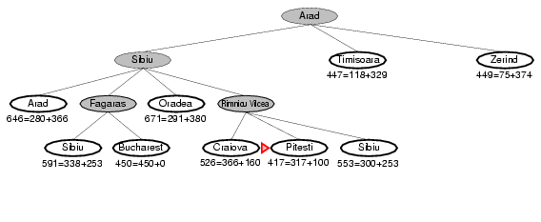
A* search example

Slide 174
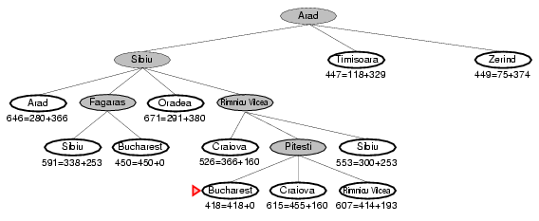
A* search example

Slide 175
A simple search problem: S is the start node, G is the goal node, the real distances are shown.
A
4
B
4
C
3
S
5
5
4
G
3.5
D
2
E
4
F
A lower-bound estimate of the distance to G could be as follows (note that we do not need it for F):
A
B
5.8
C
10.1
3.4
S
11.5
G
9.2
D
E
F
3.5
7.1

Slide 176
A*, step 1
S
3+10.1
4+9.2
A
D

Slide 177
The A* procedure (7)
A*, step 2
S
13.1
13.2
A
D
3+4+5.8
3+5+9.2
B
D

Slide 178
A*, step 3
S
13.1
13.2
A
D
12.8
17.2
B
D
3+4+4+3.4
3+4+5+7.1
C
E

Slide 179
A*, step 4
S
13.1
13.2
A
D
12.8
17.2
4+5+10.1
B
D
A
14.4
19.1
4+2+7.1
C
E
E

Slide 180
A*, step 5
S
13.1
13.2
A
D
12.8
17.2
19.1
B
D
A
14.4
19.1
13.1
C
E
E
4+2+5+5.8
4+2+4+3.5
B
F

Slide 181
A*, step 6
S
13.1
13.2
A
D
12.8
17.2
19.1
B
D
A
14.4
19.1
13.1
C
E
E
16.8
13.5
B
F
G

Slide 182
Real Time A*
Considers the cost (> 0) for switching from one branch to another in the search
Example: path finding in real life
11
11
4
4
1
1
2
2
7
7
16
16
F
F
D
D
B
B
A
A
C
C
E
E
G
G
f(B) = 1 + 1 = 2 (A) f(C) = 1 + 2 = 3
f(D) = 1 + 4 = 5 (B) f(A) = 1 + 3 = 4
f(B) = 1 + 5 = 6 (A) f(C) = 1 + 2 = 3
f(A) = 1 + 6 = 7 (C) f(E) = 1 + 7 = 8
f(B) = 1 + 5 = 6 (A) f(C) = 1 + 8 = 9
f(D) = 1 + 4 = 5 (B) f(A) = 1 + 9 = 10
f(F)=1+11= 12 (D) f(B) = 1 + 10 = 11
f(B) = 1 + 1 = 2 (A) f(C) = 1 + 2 = 3
f(D) = 1 + 4 = 5 (B) f(A) = 1 + 3 = 4
f(B) = 1 + 5 = 6 (A) f(C) = 1 + 2 = 3
f(A) = 1 + 6 = 7 (C) f(E) = 1 + 7 = 8
f(B) = 1 + 5 = 6 (A) f(C) = 1 + 8 = 9
f(D) = 1 + 4 = 5 (B) f(A) = 1 + 9 = 10
f(F)=1+11= 12 (D) f(B) = 1 + 10 = 11

Slide 183
Another Example
Current State = S
f(A) = 3 + 5 = 8
f(B) = 2 + 4 = 6
Current State = B
f(S) = 2 + 8 = 10 f(A) = 4 + 5 = 9
f(C) = 1 + 5 = 6
f(E) = 4 + 2 = 6
Current State = C
f(H) = 2 + 4 = 6
f(B) = 1 + 6 = 7
S
3
2
(5)
A
4
(4)
B
1
4
(5)
C
E
(2)
2
3
1
(4)
H
(2)
D
F
(1)
2
G
(0)

Slide 184
Another Example
Current State = H
f(C) = 2 + 7 = 9
Current State = C
f(B) = 1 + 6 = 7
f(H) = ∞
Current State = B
f(S) = 2 + 8 = 10
f(A) = 4 + 5 = 9
f(E) = 4 + 2 = 6
f(C) = ∞
Current State = E
f(B) = 4 + 9 = 13
f(D) = 3 + 2 = 5
f(F) = 1 + 1 = 2
S
3
2
(5)
A
4
(4)
B
1
4
(5)
C
E
(2)
2
3
1
(4)
H
(2)
D
F
(1)
2
G
(0)

Slide 185
Another Example
Current State = F
f(E) = 1 + 5 = 6
Current State = E
f(D) = 3 + 2 = 5
f(B) = 4 + 9 = 13
f(F) = ∞
Current State = D
f(G) = 2 + 0 = 2
f(E) = 3 + 13 = 16
Visited Nodes =
S, B, C, H, C, B, E, F, E, D, G
Path = S, B, E, D, G
S
3
2
(5)
A
4
(4)
B
1
4
(5)
C
E
(2)
2
3
1
(4)
H
(2)
D
F
(1)
2
G
(0)

Slide 186
Heuristics for Searching
For many tasks, a good heuristic is the key to finding a solution
prune the search space
move towards the goal
Relaxed problems
fewer restrictions on the successor function (operators)
its exact solution may be a good heuristic for the original problem

Slide 187

Euclidean Distance
Always pick the step that is the closed to the target.

Slide 188

Manhattan Distance
Another common Approach is to replace absolute distance with “Manhattan Distance”
This is a approximation of the distance between two points based on adding the horizontal distance and vertical distance rather than the computing the exact distance.
This is a good example of how A* algorithm can be customized for specific games and maps.

Slide 189
Nilsson's Sequence Score
Nilsson's Sequence Score: h(n) = P(n) + 3 S(n)P(n) is the manhattan distance of each tile from its proper position.
"The quantity S(n) is a sequence score obtained by checking around the noncentral squares in turn, allotting 2 for every tile not followed by its proper successor and 0 for every other tile, except that a piece in the center scores 1."
This might be easier to understand if you know that the goal state that Nilsson uses is represented by: (1 2 3 8 space 4 7 6 5). This heuristic is not admissible.

Slide 190
8-Puzzle Heuristics
E.g., for the 8-puzzle:
h₁(n) = number of misplaced tiles
h₂(n) =no. of squares from desired location of each tile
h₁(S) = ? 8
h₂(S) = ? 3+1+2+2+2+3+3+2 = 18

Slide 191
Problem-Space Graphs
Example: a small part of the 8-puzzle problem-space graph.

Slide 192
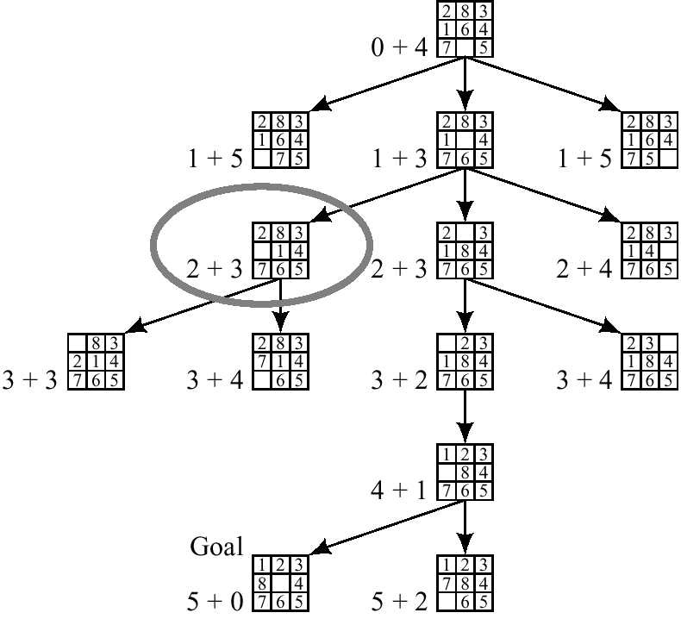
Modified heuristic for 8-puzzle

Slide 193


Slide 194
Properties of A*
A* generates an optimal solution if h(n) is an admissible heuristic and the search space is a tree:
h(n) is admissible if it never overestimates the cost to reach the destination node
A* generates an optimal solution if h(n) is a consistent heuristic and the search space is a graph:
h(n) is consistent if for every node n and for every successor node n’ of n:
h(n) ≤ c(n,n’) + h(n’)
h(n)
n
d
c(n,n’)
h(n’)
n’
If h(n) is consistent then h(n) is admissible
Frequently when h(n) is admissible, it is also consistent

Slide 195
Admissible Heuristics
A heuristic is admissible if it is too optimistic, estimating the cost to be smaller than it actually is.
Example:
In the road map domain,
h(n) = “Euclidean distance to destination”
is admissible as normally cities are not connected by roads that make straight lines

Slide 196
Example: Admissible Heuristics in 8-Puzzle Game
Heuristic: a tile A can be moved to any tile B
H1(n) = “number of misplaced tiles in board n”
Heuristic: a tile A can be moved to a tile B if B is adjacent to A
H2(n) = “sum of distances of misplaced tiles to goal positions in board n”
Some experimental results reported in Russell & Norvig (2002):
A* with h2 performs up to 10 times better than A* with h1
A* with h2 performs up to 36,000 times better than a classical uninformed search algorithm (iterative deepening)

Slide 197
Memory-Bounded Search
Search algorithms that try to conserve memory
Most are modifications of A*
Iterative deepening A* (IDA*)
Recursive Best first search
Simplified memory-bounded A* (SMA*)

Slide 198
Iterative Deepening A* (IDA*)
Explores paths within a given contour (f-cost limit) in a depth-first manner
This saves memory space because depth-first keeps only the current path in memory
but it results in repeated computation of earlier contours since it doesn’t remember its history
was the “best” search algorithm for many practical problems for some time
does have problems with difficult domains
contours differ only slightly between states
algorithm frequently switches back and forth
similar to disk thrashing in (old) operating systems

Slide 199
Recursive Best-First Search
Similar to best-first search, but with lower space requirements
O(bd) instead of O(b^{m})
It keeps track of the best alternative to the current path
best f-value of the paths explored so far from predecessors of the current node
if it needs to re-explore parts of the search space, it knows the best candidate path
still may lead to multiple re-explorations

Slide 200
Simplified Memory-Bounded A* (SMA*)
Uses all available memory for the search
Drops nodes from the queue when it runs out of space
those with the highest f-costs
Avoids re-computation of already explored area
keeps information about the best path of a “forgotten” subtree in its ancestor
Complete if there is enough memory for the shortest solution path
often better than A* and IDA*
but some problems are still too tough
trade-off between time and space requirements

Slide 201
AND/OR Graphs
Nodes represent subproblems
And links represent subproblem decompositions
OR links represent alternative solutions
Start node is initial problem
Terminal nodes are solved subproblems
Solution graph
It is an AND/OR subgraph such that:
1. It contains the start node
2. All it terminal nodes (nodes with no successors) are solved primitive problems
3. If it contains an AND node L, it must contain the entire group of AND links that leads to children of L.

Slide 202
AND/OR graphs
Some problems are best represented as achieving subgoals, some of which achieved simultaneously and independently (AND)
Up to now, only dealt with OR options
Possess TV set
Steal TV
Earn Money
Buy TV

Slide 203
Searching AND/OR graphs
A solution in an AND-OR tree is a sub tree whose leafs are included in the goal set
Cost function: sum of costs in AND node f(n) = f(n₁) + f(n₂) + …. + f(n_{k})
How can we extend A* to search AND/OR trees? The AO* algorithm.

Slide 204
AND/OR search
We must examine several nodes simultaneously when choosing the next move
A
38
B
C
D
17
9
27
E
F
G
H
I
J
(5)
(10)
(3)
(4)
(15)
(10)

Slide 205
AND/OR Best-First-Search
Traverse the graph (from the initial node) following the best current path.
Pick one of the unexpanded nodes on that path and expand it. Add its successors to the graph and compute f for each of them
Change the expanded node’s f value to reflect its successors. Propagate the change up the graph.
Reconsider the current best solution and repeat until a solution is found

Slide 206
AND/OR Best-First-Search example
1.
2.
A
A
(5)
(9)
D
(3)
B
(5)
C
(4)
3.
A
D
(10)
(9)
B
C
(3)
(4)
(10)
E
F
(4)
(4)

Slide 207
AND/OR Best-First-Search example
4.
A
(12)
B
C
D
(10)
(6)
(4)
(10)
G
H
(7)
E
F
(5)
(4)
(4)

Slide 208
Interacting Sub goals
A
D
C
E
(5)
(2)

Slide 209
AO* algorithm
Let G be a graph with only starting node INIT.
Repeat the followings until INIT is labeled SOLVED or h(INIT) > FUTILITY
Select an unexpanded node from the most promising path from INIT (call it NODE)
Generate successors of NODE. If there are none, set h(NODE) = FUTILITY (i.e., NODE is unsolvable); otherwise for each SUCCESSOR that is not an ancestor of NODE do the following:
Add SUCCESSSOR to G.
If SUCCESSOR is a terminal node, label it SOLVED and set h(SUCCESSOR) = 0.
If SUCCESSPR is not a terminal node, compute its h

Slide 210
AO* algorithm (Cont.)
Propagate the newly discovered information up the graph by doing the following: let S be set of SOLVED nodes or nodes whose h values have been changed and need to have values propagated back to their parents. Initialize S to Node. Until S is empty repeat the followings:
Remove a node from S and call it CURRENT.
Compute the cost of each of the arcs emerging from CURRENT. Assign minimum cost of its successors as its h.
Mark the best path out of CURRENT by marking the arc that had the minimum cost in step ii
Mark CURRENT as SOLVED if all of the nodes connected to it through new labeled arc have been labeled SOLVED
If CURRENT has been labeled SOLVED or its cost was just changed, propagate its new cost back up through the graph. So add all of the ancestors of CURRENT to S.

Slide 211

An Example of AO* Algorithm

Slide 212
An Example
(8)
A

Slide 213
An Example
[12]
A
[13]
4
5
B
5
(1)
D
(8)
C
(2)

Slide 214
An Example
[15]
A
[13]
4
5
5
(4)
B
D
(8)
2
C
(2)

Slide 215
An Example
[15]
A
[8]
4
5
B
5
(4)
D
(3)
2
C
2
(2)
4
E
(1)
(0)
G

Slide 216
An Example
[15]
A
[9]
4
5
B
5
(4)
D
(4)
2
C
2
(2)
2
4
E
(3)
3
(0)
G

Slide 217
An Example
[15]
A
Solved
4
5
B
5
Solved
(4)
D
2
C
2
(2)
2
4
E
(3)
3
(0)
G
Solved

Slide 218
Problem Reduction
Goal: Acquire TV set
Goal: Steal TV set
Goal: Earn some money
Goal: Buy TV set
AND-OR Graphs
Algorithm AO* (Martelli & Montanari 1973, Nilsson 1980)

Slide 219
Problem Reduction: AO*
A
A
6
5
9
B
C
D
3
4
5
A
9
A
11
9
12
B
C
D
10
B
6
C
D
10
3
4
4
E
F
G
H
E
F
4
4
5
7
4
4

Slide 220
Problem Reduction: AO*
A
11
A
14
B
13
C
10
B
13
C
15
D
5
E
6
F
3
D
5
E
6
F
3
G
5
G
10
Necessary backward propagation
H
9

Slide 221
Local Search Algorithms
In many optimization problems, the path to the goal is irrelevant; the goal state itself is the solution.
State space = set of "complete" configurations
Find configuration satisfying constraints, e.g., n-queens
In such cases, we can use local search algorithms
Keep a single "current" state, try to improve it.
Very memory efficient (only remember current state)
Based on the local view.

Slide 222
Local Search Algorithms
Local search algorithms work as follows:
Pick a solution from the search space and evaluate it. Define this as the current solution.
Apply a transformation to the current solution to generate and evaluate a new solution.
If the new solution is better than the current solution then
exchange it with the current solution; otherwise discard the
new solution.
Repeat steps 2 and 3 until no transformation in the given set
improves the current solution.

Slide 223
Local Search Algorithms
Example: Car driver driving a car on a road with a number of curve up the hill, with possibility of multiple junctions and routes.
Issue: No one can assure that the best solution is found.

Slide 224


Local Search(Iterative Improvement) Algorithms

Slide 225

Example: n-queens
Notes:
h = number of pairs of queens that are attacking each other, either directly or indirectly

Slide 226
Example: TSP
TSP: Let G be a (directed or undirected) graph of n nodes with each edge assigned a non-negative cost. Find the lowest-cost path of G that visits each node only once and returns to a given initial node.
Solution set: the set of permutations of the n cities.
Any permutation yields an ordered list of the cities to be visited, starting at the salesman's home base, and continuing to the last location before returning home.
Notes:
All possible arrangements of a collection of things, where the order is important. Example: You want to visit the homes of three friends Alex ("a"), Betty ("b") and Chandra ("c"), but haven't decided in what order. What choices do you have? Answer: {a,b,c} {a,c,b} {b,a,c} {b,c,a} {c,a,b} {c,b,a} (Consider all nodes firstly visited) If the order does not matter, it is a Combination

Slide 227
Algorithm for TSP
1. Start with an arbitrary complete tour T (i.e., a random permutation).
2. Define the neighbourhood of T as the set of all tours that can be reached by a 2-interchange move.
3. Search in the neighbourhood of T for a new tour T0. If this tour is better than T (i.e., it has lower cost), then replace T with T0.
If you cannot find a better tour, terminate.
Notes:
A neighbourhood of a point is a set of region containing the point, where one can attain that point without leaving the region. For a given set state
S(s E S), a set N(s) represents neighbouring solutions that can be attained in the given region. This N(s) is neighbourhood of s.
Tour is a cycle that visit each node exactly once.

Slide 228
Local Search Algorithms
Thus local search algorithms operate using a single current state(rather than multiple paths as e.g., A*) and generally move only to neighbours of that state.
At each step of a local search algorithm we have a complete but imperfect solution to a search problem. Other algorithms(e.g., A*) work with partial solutions and extend them to complete ones.
Good properties of local search algorithms:
Constant space
Suitable for on-line as well as off-line problems.
Can find reasonable solutions in large solution spaces

Slide 229
Hill-climbing search
In a search methods, we continuously update the search space with reference to the goal state.
In hill climbing, search begins with the random point in search space(always moves uphill).
Basic Idea: Always head towards the state which is better than the current state. Always move to the neighbor with a better score. No neighbor better than the current state, then program stop.
Since it is always moving to the node which has better value, it is very greedy and can easily stuck.

Slide 230
Hill-climbing search Algorithm
To determine whether current state is better or not, an evaluation function (heuristic) is used.
Generally better state means a higher value of evaluation function.
This algorithm make incremental changes in the optimal direction based on heuristics.

Slide 231


Hill-climbing search
"Like climbing Everest in thick fog with amnesia"

Slide 232
Example: TSP
Begin with the initial step.(a city salesman has visited)
Move in a direction so that city is not repeated, but additional city is visited(better state).
Heuristics can be number of cities visited.
Keep moving in the state that improves the number of cities with legal action.
When, there is no way to improve heuristic function,stop.

Slide 233

Hill-climbing search: 8-queens problem
Each number indicates h if we move
a queen in its corresponding column
h = number of pairs of queens that are attacking each other, either directly or indirectly

Slide 234

Hill-climbing search: 8-queens problem
A local minimum with h = 1
What can you do to get out of this local minima?

Slide 235
Hill-climbing search Problems
The process may reach a solution, where no other better solution is available in percept. In short, no transition improves the situations.
Typically it happens when it reaches a local maximum, plateau, or ridge.

Slide 236
Problem
Local maxima: This is a state better than the local region or neighboring states, but not a global maxima. This occurs since a better solution exit which is not in the vicinity of the present state.
Plateau: This refers to a flat area or space where neighborhood states have the same value as the present state and hence fail to determine the best direction to move on.
Ridge: It is a search space at a higher attitude than the surroundings. It cannot be traversed by single move.
Notes:
Vicinity : area near to surrounding space.

Slide 237

Hill-climbing in Continuous Spaces
Problem: depending on initial state, can get stuck in local maxima

Slide 238
Variations of Hill Climbing Search
In simple hill climbing, the first closer node is chosen, whereas in steepest ascent hill climbing all successors are compared and the closest to the solution is chosen. Both forms fail if there is no closer node, which may happen if there are local maxima in the search space which are not solutions.
Stochastic Hill climbing does not examine all neighbors before deciding how to move. Rather, it selects a neighbor at random, and decides (based on the amount of improvement in that neighbor) whether to move to that neighbor or to examine another.

Slide 239
Variations of Hill Climbing Search
First Choice hill climbing generates random successors until one is better. It is good for the states with high number of neighbors.
Random-restart hill climbing is iteratively does hill-climbing, each time with a random initial condition . The best is kept: if a new run of hill climbing produces a better than the stored state, it replaces the stored state.
Random-restart hill climbing is a surprisingly effective algorithm in many cases.
Evolutionary hill climbing represents potential solutions as strings and perform random mutations. It keeps the mutations that are better states.

Slide 240
Simulated annealing search
Based on metallurgy concept of annealing(a heat treatment that alters the microstructure of a material causing changes in properties such as strength, hardness, and ductility)
Idea: escape local maxima by allowing some random and bad moves but gradually decrease their frequency.

Slide 241

Simulated annealing search

Slide 242
Example: 8-puzzle
Tins is works on the principle of computing the energy. This energy is computed based on the distance measure.
Example: an absolute distance(position where the no. is –position where the no. should be)
The temperature is set to some value, which is decremented or revised at every iteration.

Slide 243
Example: 8-puzzle
3 | 1 | 4
5 | 2 | 7
6 | 8
1 | 2 | 3
4 | 5 | 6
7 | 8
Initial State
Goal State
Energy for the initial states is given as:
(2-1) + (5-2) + (3-1) + (4-3) + (5-4) + (7-6) + (7-6) + (8-8) = 10
There are two different cases possible after this state.
Since Difference is not less than zero, we need to consider probabilities and select the next state.

Slide 244
Local Beam Search
It is a heuristic search algorithm.
This algorithm explores the states or graph by expanding the most promising nodes in a limited set.
At any level, it expands identified best node.
There can be more than one node identified at each level, say K.
Based on BFS to build search tree.

Slide 245
Local Beam Search Algorithm
Keep track of k states rather than just one
Start with k randomly generated states
At each iteration, all the successors of all k states are generated.
If any one is a goal state, stop; else select the k best successors from the complete list and repeat.

Slide 246
Local Beam Search Example
Example: Select best engg. Student from country.
Country -> Cities->Colleges -> Courses-> Divisions -> Students who scored maximum marks-> select best student
We can used Search tree representation.

Slide 247
Tabu Search
Tabulist (list of recent history of search)is used for recently visited states and are temporarily excluded from being visited again.
It avoids getting stuck in local maxima.

Slide 248
Genetic algorithms
A successor state is generated by combining two parent states
Start with k randomly generated states (population)
A state is represented as a string over a finite alphabet
(often a string of 0s and 1s)
Evaluation function (fitness function). Higher values for
better states.
Produce the next generation of states by selection,
crossover, and mutation

Slide 249

Searching with nondeterministic actions

Slide 250

AND OR SEARCH TREES

Slide 251
Searching with partial observations
Searching with No observation
Searching with observations

Slide 252


Slide 253

Online Search Agents and Unknown Environments

Slide 254


Slide 255

Online Search Agents

Slide 256
Adversarial search methods(Game Theory)
A game is any situation involving interdependence amongst ‘players’.
A game consists of
a set of players
a set of strategies for each player
the payoffs to each player for every possible list of strategy choices by the players.
Game theory is the study of strategic decision making.
Game theory models strategic behavior by agents who understand that their actions affect the actions of other agents.
Notes:
Payoff(benefits received)

Slide 257
Game Playing
Game playing is most practical and direct application of the heuristic search problem solving paradigm.
Games require different search procedures.
Basically they are based on generate and test philosophy.
Typical characteristic of the games is to ‘look ahead’ at future positions in order to succeed.
The generator generates individual move in the search space, each of which is then evaluated by the tester and the most promising one is chosen.
It is clear that to improve the effectiveness of a search for problem solving programs, there are two things that can be done:
Improve the generate procedure so that only good moves (paths) are generated.
Improve the test procedure so that the best moves (paths) will be recognized and explored first.

Slide 258
Formal definition game as a search problem
Initial state: Set-up specified by the rules, e.g., initial board configuration of chess.
Player(s): Defines which player has the move in a state.
Actions(s): Returns the set of legal moves in a state.
Result(s,a): Transition model defines the result of a move.
Successor function: list of (move,state) pairs specifying legal moves.
Terminal-Test(s): Is the game finished? True if finished, false otherwise.
Utility function(s,p): Gives numerical value of terminal state s for player p.
E.g., win (+1), lose (-1), and draw (0) in tic-tac-toe.
E.g., win (+1), lose (0), and draw (1/2) in chess.

Slide 259

Types of Games
battleship
Kriegspiel
.
Zero-sum: one player’s loss is the other’s gain
Perfect-information because both players have access to the same information about the game in progress (card games are not perfect - information games). No information is hidden from either player

Slide 260
Search versus Games
Search – no adversary
Solution is (heuristic) method for finding goal
Heuristics and CSP techniques can find optimal solution
Evaluation function: estimate of cost from start to goal through given node
Examples: path planning, scheduling activities
Games – adversary
Solution is strategy
strategy specifies move for every possible opponent reply.
Time limits force an approximate solution
Evaluation function: evaluate “goodness” of game position
Examples: chess, checkers, Othello, backgammon
Notes:
Adversary : a person, group, or force that opposes or attacks; opponent; enemy

Slide 261
Game tree
Game tree for the game—a tree where the nodes are game states and the edges are moves.
Game Tree is a structure for organizing all possible (legal) game states by the moves which allow you to transition from one game state to the next.
This structure is ideal for allowing the computer to evaluate which moves to make because, by traversing the game tree, a computer can easily “foresee” the outcome of a move and thus “decide” whether to take it.

Slide 262
Game Tree
The game begins from a specified initial state and ends in position that can be declared win for one, loss for other or possibly a draw.
Game tree is an explicit representation of all possible plays of the game.
The root node is an initial position of the game.
Its successors are the positions that the first player can reach in one move, and
Their successors are the positions resulting from the second player's replies and so on.
Terminal or leaf nodes are represented by WIN, LOSS or DRAW.
Each path from the root to a terminal node represents a different complete play of the game.
Notes:
Explicit representation : clearly developed representation.

Slide 263
Game Tree
We look at techniques for choosing a good move when time is limited.
Heuristic evaluation functions allow us to approximate the true utility of a state without doing a complete search.
We first consider games with two players, whom we call MAX and MIN.
MAX moves first, and then they take turns moving until the game is over. At the end of the game, points are awarded to the winning player and penalties are given to the loser.

Slide 264
Game tree
Let us consider only two player discrete, perfect information games, such as tic-tac-toe.
From the initial state, MAX has nine possible moves. Play alternates between MAX 's placing an X and MIN's placing an 0 until we reach leaf nodes corresponding to terminal states such that one player has three in a row or all the squares arc filled.
The number on each leaf node indicates the utility value of the terminal state from the point of view of MAX; high values are assumed to be good for MAX and bad for MIN (which is how the players get their names).

Slide 265

Partial Game Tree for Tic-Tac-Toe
MAX(X)
MIN(O)
MAX(X)
MIN(O)
f(n) = +1 if the position is a win for X.
f(n) = -1 if the position is a win for O.
f(n) = 0 if the position is a draw.
Terminal
utility
Win for MIN
Draw
Win for MAX

Slide 266
Correspondence with AND/OR graph
The correspondence between game tree and AND/OR tree is obvious.
The moves available to one player from a given position can be represented by OR links.
Whereas the moves available to his opponent are AND links.
The trees representing games contain two types of nodes:
MAX- nodes (nodes with OR links, maximizing its gain)
MIN - nodes (nodes with AND links, minimizing opponent’s its gain)

Slide 267
Game tree
The leaf nodes are leveled WIN, LOSS or DRAW depending on
Whether they represent a win, loss or draw position from MAX's view point.
Each non-terminal nodes in the game tree can be labeled WIN, LOSS or DRAW by a bottom up process similar to the "Solve" labeling procedure in AND/OR graph.

Slide 268
Status Labeling Procedure
If j is a non-terminal MAX node, then
WIN , if any of j's successor is a WIN
STATUS (j) = LOSS , if all j's successor are LOSS
DRAW, if any of j's successor is a DRAW and none is WIN

Slide 269
Status Labeling Procedure
If j is a non-terminal MIN node, then
WIN , if all j's successor is a WIN
STATUS (j) = LOSS , if any of j's successor are LOSS
DRAW, if any of j's successor is a and none is LOSS
The function STATUS(j) should be interpreted as the best terminal status
MAX can achieve from position j, if MAX plays optimally against a perfect opponent.

Slide 270
How to play a game
A way to play a game is to:
Consider all the legal moves you can make
Compute the new position resulting from each move
Evaluate each resulting position and determine which is best
Make that move
Wait for your opponent to move and repeat

Slide 271
MiniMax Algorithm
A minimax algorithm is a recursive algorithm for choosing the next move in an n-player game, usually a two-player game.
The minimax algorithm is used to determine which moves a computer player makes in games like tic-tac-toe, checkers.
A value is associated with each position or state of the game. This value is computed by means of a position evaluation function and it indicates how good it would be for a player to reach that position.
The player then makes the move that maximizes the minimum value of the position resulting from the opponent's possible following moves. If it is A's turn to move, A gives a value to each of his legal moves.

Slide 272
MiniMax Algorithm
Uses a bottom-up approach. Two players - Max and Min. We assume both Max and Min will play optimally.
General Idea: 1. Start with the current position as a Max node. 2. Expand the game tree a fixed number of half-moves (known as a ply.) 3. Apply the evaluation function to the leaf nodes. 4. Calculate values back up the game tree according to Min-Max principle. 5. Pick the move that was chosen to give the Max value at the root.

Slide 273
Minimax procedure
Create start node as a MAX node with current board configuration
Expand nodes down to some depth of lookahead in the game.
Apply the evaluation function at each of the leaf nodes
“Back up” values for each of the non-leaf nodes until a value is computed for the root node
At MIN nodes, the backed-up value is the minimum of the values associated with its children.
At MAX nodes, the backed up value is the maximum of the values associated with its children.
Pick the operator associated with the child node whose backed-up value determined the value at the root

Slide 274

Example_1

Slide 275

Example_2

Slide 276
Evaluation function
Evaluation function or static evaluator is used to evaluate the “goodness” of a game position.
Contrast with heuristic search where the evaluation function was a non-negative estimate of the cost from the start node to a goal and passing through the given node
The zero-sum assumption allows us to use a single evaluation function to describe the goodness of a board with respect to both players.
f(n) >> 0: position n good for me and bad for you
f(n) << 0: position n bad for me and good for you
f(n) near 0: position n is a neutral position
f(n) = +infinity: win for me
f(n) = -infinity: win for you

Slide 277
Evaluation function examples
Example of an evaluation function for Tic-Tac-Toe
f(n) = [# of 3-lengths open for me] - [# of 3-lengths open for you]
where a 3-length is a complete row, column, or diagonal
Alan Turing’s function for chess
f(n) = w(n)/b(n) where w(n) = sum of the point value of white’s pieces and b(n) = sum of black’s
Most evaluation functions are specified as a weighted sum of position features
f(n) = w₁*feat₁(n) + w₂*feat₂(n) + ... + w_{n}*feat_{k}(n)

Slide 278
Tic-Tac-Toe
X : MAX player
0 : MIN player
e(p) = (rows + cols + diagonals open to ‘X’) – (Same to ‘0’)
(MAX) Start
e(p) = 0
X
X
X
X’s Turn
e = 8 – 4 = 4
e = 8 – 6 = 2
e = 8 – 5 = 3
X
X
0’s Turn
0
0
e = 4 – 2 = 2
e = 4 – 3 = 1
Notes:
278

Slide 279

Notes:
279

Slide 280
Alpha-Beta Pruning
Pruning allows us to ignore portions of the search tree that make no difference to the final choice.
Generate the game tree to depth h in depth-first manner
Back-up estimates (alpha and beta values) of the evaluation functions whenever possible
Prune branches that cannot lead to changing the final decision

Slide 281
Alpha-beta pruning
We can improve on the performance of the minimax algorithm through alpha-beta pruning.
Basic idea: “If you have an idea that is surely bad, don't take the time to see how truly awful it is.” -- Pat Winston
MAX
>=2
We don’t need to compute the value at this node.
No matter what it is, it can’t affect the value of the root node.
MIN
=2
<=0
MAX
2
7
0
?

Slide 282
Alpha-beta pruning
Traverse the search tree in depth-first order
At each MAX node n, alpha(n) = maximum value found so far
At each MIN node n, beta(n) = minimum value found so far
Note: The alpha values start at -infinity and only increase, while beta values start at +infinity and only decrease.
Beta cutoff: Given a MAX node n, cut off the search below n (i.e., don’t generate or examine any more of n’s children) if alpha(n) >= beta(i) for some MIN node ancestor i of n.
Alpha cutoff: stop searching below MIN node n if beta(n) <= alpha(i) for some MAX node ancestor i of n.

Slide 283
Alpha-Beta Procedure
Discontinue the search below a MAX node N
if its alpha is ≥ beta of a MIN ancestor of N
Discontinue the search below a MIN node N
if its beta is ≤ alpha of a MAX ancestor of N
The alpha of a MAX node is a lower bound on the backed-up value.
The beta of a MIN node is a higher bound on the backed-up value.
Update the alpha/beta of the parent of a node N when all search below N has been completed or discontinued

Slide 284

Example_1

Slide 285


Slide 286

Example_2
Notes:
Assume we have evaluated, using depth first search down to node I. This means we can maximise node D to a value of 6. If we now continue the search we will eventually evaluate node J and assign it a value of 8. At this point we do not need to evaluate K (or any of its siblings); for the following reasons.Node E already has a value of at least 8 (as MAX is trying to maximise this value so it cannot take on a smaller value).
Node E is already greater than node D and, as MIN will be trying to minimise these two values, it is always going to choose D over E.
Therefore, we can cut off the search at this point (shown an the diagram).
Similarly, we can cut of the search from node G downwards.
Having evaluated F to 2, C cannot be more than this value (as C is trying to minimise).
B is already greater than 2.
Therefore, MAX is always going to prefer B over C, so we cannot cut off the rest of the search below C.
The improvements we can get with alpha-beta searching depends on the problem being considered and the order in which the nodes are expanded. At worst, it will perform the same as minimax (i.e. no pruning will be possible). At best, alpha-beta pruning can effectively double the search space.

Slide 287
Effectiveness of alpha-beta
Alpha-beta is guaranteed to compute the same value for the root node as computed by minimax, with less or equal computation
Worst case: no pruning, examining b^d leaf nodes, where each node has b children and a d-ply search is performed
Best case: examine only (b)^(d/2) leaf nodes.
Result is you can search twice as deep as minimax!
Best case is when each player’s best move is the first alternative generated
In Deep Blue, they found empirically that alpha-beta pruning meant that the average branching factor at each node was about 6 instead of about 35!

Slide 288
Stochastic Games
In game theory, a stochastic game is a dynamic game with probabilistic transitions played by one or more players.
The game is played in a sequence of stages.
In a stochastic game the play proceeds by steps from position to position, according to transition probabilities controlled jointly by the two players.

Slide 289
Constraint Satisfaction Problem
A constraint satisfaction problem (or CSP) is a special kind of problem that satisfies some additional structural properties beyond the basic requirements for problems in general.
In a CSP, the states are defined by the values of a set of variables and the goal test specifies a set of constraints that the values have to obey.

Slide 290
Constraint Satisfaction Problem
CSP = {V, D, C}
Variables: V = {V1,..,VN}
Example: The values of the nodes in the graph
Domain: The set of d values that each variable can take
Example: D = {R, G, B}
Constraints: C = {C1,..,CK}
Each constraint consists of a tuple of variables and a list of values that the tuple is allowed to take for this problem
Example: [(V2,V3),{(R,B),(R,G),(B,R),(B,G),(G,R),(G,B)}]
Constraints are usually defined implicitly.
A function is defined to test if a tuple of variables satisfies the constraint

Slide 291
CSP as search problem
A CSP can be given an incremental formulation as a standard search problem as follows:
Initial state: the empty assignment fg, in which all variables are unassigned.
Successor function: a value can be assigned to any unassigned variable, provided that it does not conflict with previously assigned variables.
Goal test: the current assignment is complete.
Path cost: a constant cost (e.g., 1) for every step.

